Slide 1


Perspective on VNRs and VLRs
Sheka Bangura, PhD
Ministry of Planning and Economic Development
Sierra Leone
APRM-UNDESA Capacity Building Workshop on Africa’s VNR for the HLPF-2022 and Domestication of the Agenda 2063
Abuja, Nigeria 28-29 March 2022

Slide 2
Outline
Responding to Workshop Questions from Sierra Leone’s Perspective
  How do you assess VNRs 2021: did they reflect special or outstanding content due to the COVID-19 pandemic?
  What are the main pieces of advice to share with African countries presenting a VNR in 2022?
  How can the VLRs contribute to robust and inclusive national and regional review processes?
  What are key lessons learned in relation to VLRs?
Concluding Remarks

Slide 3
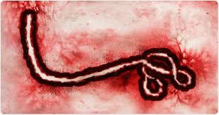

How do you assess VNRs 2021: did they reflect special or outstanding content due to the COVID-19 pandemic?
Nonetheless, our experience with the Ebola virus disease 2013-16 provided useful lessons for our response to COVID-19 that could have minimised effect of the pandemic on our economy: a) we took swift and broad actions before the country could record its 1st COVID Index Case on 30th March 2020; tightening IPC protocols at border entry points 4 months before our Index Case; b) we strengthened development cooperation
Ebola
COVID-19 Pandemic was a major background context captured in Sierra Leone’s 2021 VNR (its 3rd National Report on the SDGs implementation to the UN).
We were very hopeful of an accelerated implementation & results following our 2nd VNR of July 2019 before COVID hit the world later in the year; dashing our hopes.
Like other small and externally dependent countries, Sierra Leone’s economy was immediately thrown off-balance at the eruption of the pandemic, despite the relatively few infections (as at 3rd June 2021 at 17:20 GMT, the total reported COVID cases for S/Leone were 4,156; deaths 79).
In 2020, GDP growth estimated minus 2.0 percent, while income poverty and vulnerability heightened.
COVID

Slide 4
What advice to share with African countries presenting a VNR in 2022?
While COVID restriction appears to be easing out, funding VNRs could remain a challenge for LDCs, as we encountered in 2021. Therefore:
Central governments should strengthen cooperation with development partners to support the 2022 processes; as well as cooperation within the public sector
Utilise existing structures of CSOs/NGOs at district and community levels to collect data/organise consultations on progress in the implementation.
Utilise existing (secondary information), such as Annual Progress Reports on implementation of NDPs & other sources, including relevant studies & surveys
Some VNR Data tools: Rapid Impact Evaluatns., UNICEF U-Report Technology;
qualitative questionnaire to various stakeholders; My World Survey—UN Global Security for a Better World
Focus of the 2022 VNR Reports
The Reports could focus on a few SDGs. S/Leone’s 2019 and 2021 VNRs principally focused on its 2 accelerator SDGs 4 and 16, while providing basic updates on others.
You can make your report evaluative, focusing on key policy action results under 1 or 2 SDGs.
Virtual presentation from capital, as we did in 2021
Make sure you prepare backup presentations to send to the UN ahead: audiovisual PowerPoint presentations with technical notes are crucial to cushion any unforeseen technical hitches.
Technical staff should be alert with multiple laptop computers connected online to provide backups to the equipment used by the presenter.

Slide 5
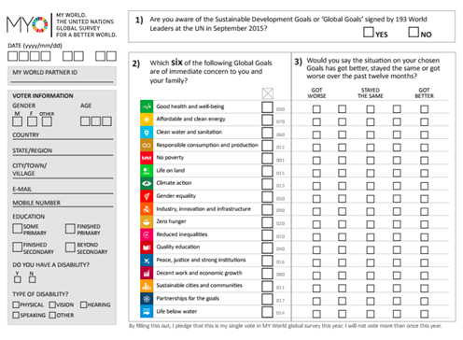
My World Survey: UN Global Security for a Better World

Slide 6
What are the main pieces of advice to share with African countries presenting a VNR in 2022?
A further testimony on the need for increased cooperation in the VNR processes: From S/Leone’s 2019 VNR distribution of delegates to the UN HLPF and
sources of funding the delegates
Distribution of 2019 VNR Delegates to the HLPF
Distribution of sources of Funding Delegates
Delegates | # | %
Central Government | 15 | 48
CSOs/NGOs | 13 | 42
Private/Research Institutions | 3 | 10
Total | 31 | 100
Sources of funding Delegates | # | %
Central Government | 8 | 26
Donor Agencies | 10 | 32
CSOs/NGOs | 9 | 29
Government/CSOs/NGOs | 1 | 3
Private/Research Institutions | 3 | 10
Total | 31 | 100

Slide 7
How can the VLRs contribute to robust and inclusive national and regional review processes?
We have not done an exclusive VLR before; we are doing the first one this year, 2022
However, all 3 VNRs we have done had local review content, gauging community response on SDG progress at local level with a clear research instrument (questionnaire) administered by CSOs/NGOs
VLRs are critical, especially in a decentralised governance system, in that service delivery tangibly takes place at local/community level
Ascertaining how effective the delivery mechanism is at that level is critical to any VNR or VRR processes

Slide 8
What are key lessons learned in relation to VLRs?
While we have not done an exclusive VLR before to share effective lessons from the process, it is important to not that:
It is crucial that all National or Regional Reviews should capture “local content”, even if exclusive VLRs are not undertaken
Each time we did a VNR in Sierra Leone, we administered a research instrument to gauge the perception of the people at local level as to how well they thought their districts/communities had done in the implementation of the SDGs, asking specific, relevant questions drawn from SDGs targets and indicators domesticated.
This has been extremely helpful in providing information on SDGs status where data was absent to report progress at outcome/impact indicator level

Slide 9
Conclusion
Voluntary Review processes are worthy of sustaining because our experience shows that they are invaluable instruments to strengthen legitimacy of local and national planning and delivery processes
They bring about a better appreciation of state service delivery efforts while promoting peace and social cohesion, with the active involvement of CSOs/NGOs and the people themselves

Slide 10
THANKS

