Slide 1
Promoting Gender Equality and Women Empowerment in Eswatini

Slide 2
PRESENTATION OUTLINE
Background
Good practices of women engagement in policy making
Good practices supporting women and girls to participate meaningfully in formal economic activities
Good practices of improving access to productive resources (e.g. Land and credit) for women
Notes:
Atelier avec plusieurs parties prenantes (Ministères, Sections de l’UNICEF, SP/REFES, ISTEEBU, PAM, l’Université de Burundi, etc) pour choisir les dimensions et indicateurs qui représente la pauvreté chez l’enfant burundais en se basant sur les bases de données ECVMB

Slide 3
Back ground
Eswatini is committed to working towards achieving the SDGs by 2030.
The country has been making good progress in terms of improving the participation of women in policy formulation, in decision making (particularly at political level), in economic activity (measures to enable them to enter formal economy) and securing their rights to economic resources (land and finance).
Commitment to a number of regional and international instruments to promote gender equality, including the Convention for the Elimination of All Forms of Discrimination against Women (CEDAW), which Eswatini ratified without reservation, and the Southern African Development Community (SADC) Declaration on Gender and Development.

Slide 4
Good Practices of Women Engagement in Policy Making
In an endeavor to ensure participation of Women in decision making processes or to reach the national target of 30 percent women representation in parliament government endorsed the 2018 Election of Women Act.
This Act is designed to fullfill the constitutional requirement for quotas for the representation of women and marginalized groups in parliament.
During the last national election in 2018, government in collaboration with partners re- enforced the women election campaign before and after the elections to educate the public and change perceptions on empowering women.
These efforts yielded positive progress with the proportion of seats held by women in the national parliament increasing slightly from 18 percent in 2013 to 22 percent.
Similarly, women representation in cabinet increased from 25 percent in 2016 to 29 percent.

Slide 5
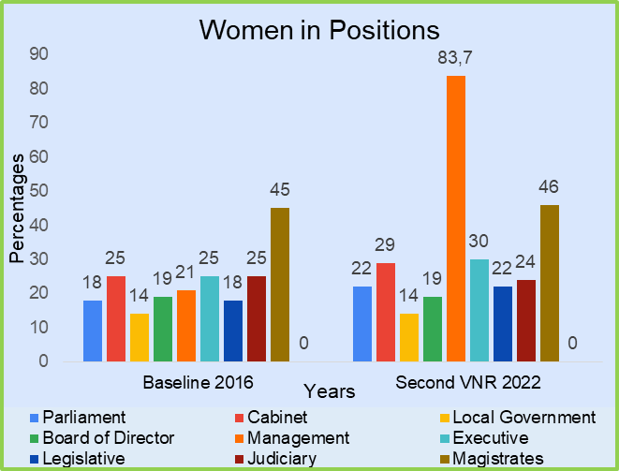
Women in decision making positions

Slide 6
Good Practices of Women Engagement in Policy Making: Cont.
Reforms in government policy and processes;
Inclusive and participatory policy development process ensuring engagement of all relevant stakeholders
Equal representation and participation of both men and women throughout the process.

Slide 7
Good Practices Supporting Women and girls to participate in Formal Economic Activities
In the education sector, government continues to provide equal opportunities for both boys and girls to access education under the Free Primary Education programme.
The 2018 National Education and Training Sector policy ensures improved access to education for all (high teenage pregnancy levels 2020)
Government through health centres and outreach community services, provides services and information on sexual and reproductive health. Establishment of home based care centres (Gogo centres) and public pre- schools which takes care of children while their parents are at work. These have a bearing on women’s ability to participate in economic activity.
SME Financing (MCIT) , communities and women in particular are supported to organize themselves into business groups, networks and associations and are able to access. Business incubator hubs (RSTP)
COVID-19 tests subsidy in support of women engaged in informal trade during the pandemic. government provided a E650 subsidy to cushion small and medium enterprises, particularly informal traders which accounts for a significant number of women in the country

Slide 8
Good Practices of improving Access to productive resources (e.g. Land and credit) for Women
The National Constitution of 2005 and Deeds Registry Act 2012 which are legal frameworks that guarantee women’s equal rights to land ownership and/or control as men.
Initiated legislative reforms for the promotion and protection of women’s rights in a marriage. These include the amendments to the 1964 Marriage Act (Women’s assets ownership in marriage).
Woman Farmer of the year and Business woman of the year campaigns through the Ministry of Agriculture in collaboration with the Ministry of Commerce, Industry and Trade that seek to promote women participation in the economy.
Establishment of the Centres for Financial Inclusion which empower vulnerable groups and support them to access finance for business purposes.
Challenges face by the country to improve access to productive resources for women include delays in the finalization of the land policy.

