Slide 1
APRM / UN DESA
CAPACITY-BUILDING WORKSHOP
Africa's Voluntary National Reviews for the HLPF 2022 and Domestication of Agenda 2063
Session One: VNRs and Lessons Learned From COVID-19
South Africa’s Presentation
28 March 2022

Slide 2
SESSION GUIDING QUESTIONS
What key lessons can be drawn from the VNR preparatory processes?
How have countries reflected the localization of the SDGs and Agenda 2063, including through voluntary local reviews (VLRs)?
What innovative approaches/tools have African governments adopted to prepare VNRs considering the ongoing impacts of the COVID-19 pandemic?
Did the pandemic provide an opportunity to improve governments' accountability and ownership as regards the implementation of Agenda 2063 and the 2030 Agenda, and if so, how?

Slide 3
INTRODUCTION
The outbreak of the pandemic came as a shock.
Though it started as a health shock with terrible illness and death, it became more than these. It had economic and social ills.
Life, as we know it, had to drastically change.
No time to ponder on what needed to be done – decisiveness was critical.
COVID-19 recovery presents us with an opportunity to urgently transform and act fast towards a more equitable and sustainable pathways for implementation of Development Agendas.
COVID-19 relief actions has created deep cuts into existing programmes and budgets - thus undermining continuity, consistency and sustainable development.
Most importantly, COVID outbreak is a reminder that ours is a global village - We are interconnected.

Slide 4
VNR PREPARATORY PROCESSES
SA Presented its Frist VNR in 2019 and aim to do a 2nd in 2023
Lessons Learned:
Importance of partnership and collaboration
Importance of advance planning and preparation
Importance of statistical data
Institutional coordination mechanism
The integrated nature of the development goals
Development agendas should be approached with a sense of urgency

Slide 5
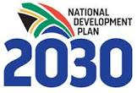
SA’s LOCALISATION OF SDGs AND AGENDA 2063
The NDP remains our Country Plan and is aligned to international, continental and regional commitments

Slide 6
SA’s APPROACH
National Development Plan
IDP
DGDP
PGDP
MTSF
(Sector plans)
Regional
(SADC)
Agenda
2063
SDG

Slide 7
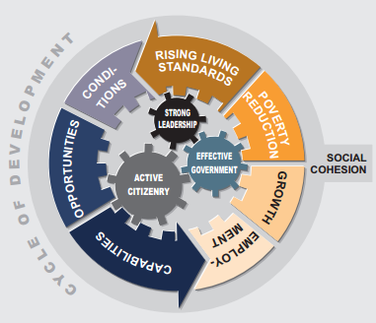
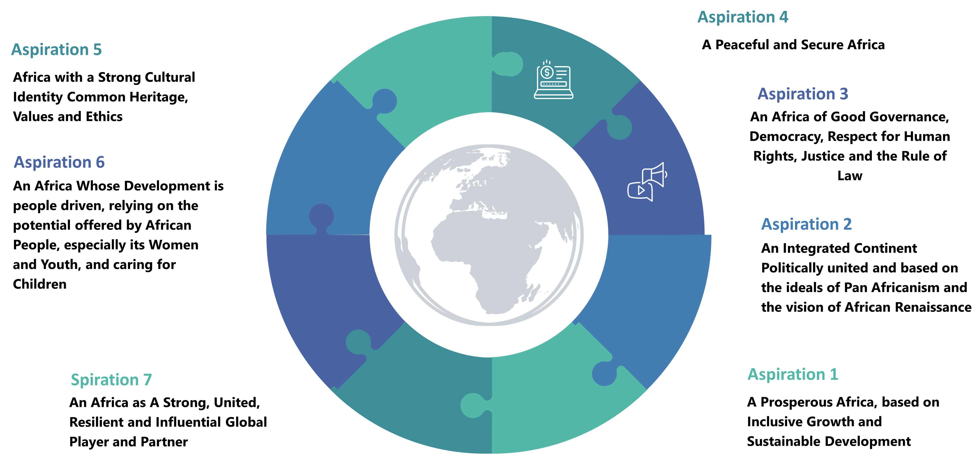
NDP, SDGs AND AGENDA 2063

Slide 8
SDGs AND AGENDA 2063 CONVERGENCE
Agenda 2030
Agenda 2063
90% Convergence
An integrated continent, politically united and based on the ideal Pan-Africanism and the vision of Africa’s Renaissance
An Africa with a strong cultural identity, common heritage, shared values and ethics
The security agenda, including the project for a common defence, foreign and security policy for the continent
Inequality within and among countries
Sustainable consumption and production
Terrestrial ecosystems, forests, desertification, land degradation and biodiversity
Social development
Economic development
Climate change and some elements from SDGs
Peaceful and inclusive societies and responsive institutions

Slide 9
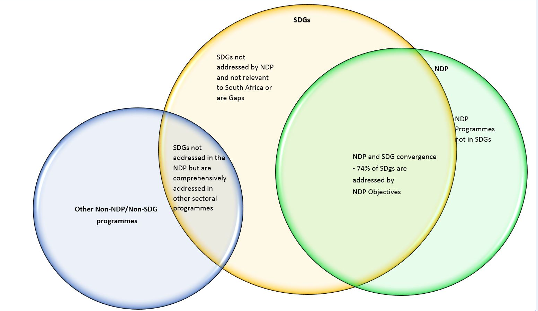
MAPPING EXERCISE - SDGs AND NDP CONVERGENCE

Slide 10
MAPPING EXERCISE – AGENDA 2063 AND NDP CONVERGENCE

Slide 11
“Vision without action is merely a dream. Action without vision just passes the time. Vision with action can change the world” – Joel Barker
AGENDA 2030
AGENDA 2063
ACTION
DOMESTICATION
NATIONAL DEVELOPMENT PLANS AND STRATEGIES

Slide 12
COVID-19 AND SA APPROACH
Government responded to pandemic in three phases:
Phase 1 - to preserve the economy through a set of immediate, targeted and temporary responses.
Phase 2 - plan to recover from the immediate effects of the crisis by supporting investment and employment.
Phase 3 - pivot to position the economy for faster growth needed to restore country’s long‐term prosperity.
State of disaster announcement
Lockdowns to minimise strain on health system, to allow health sector to prepare and to reduce number of infections
Coordinated approach Adoption - using existing structures and establishing new ones.
Development of institutional architecture - National Coronavirus Command Council, Ministerial Advisory Committees, NatJoints
Approach assisted with coordination of activities and facilitate rapid executive action
Communication Strategy
Large‐scale economic relief - fiscal package
Implementation of social protection systems & measures – increase in grant amounts.
Provision of water supply to vulnerable communities
access to quality basic health care and services; access to sexual & reproductive health services to women, provisions were made for access to chronic medication, such as antiretrovirals
Prevalence of malnutrition - food parcels distribution

Slide 13
COVID-19 LESSONS
IMPORTANCE OF:
sound policy making towards achieving the intended results
Coherence in policy making
Having proper regulation
Having proper monitoring and evaluation system
Strong statistical systems
The interface between policy and science
Efficient institutional arrangement
Collaboration and coordination to achieve intended results
Consistent communication
Multi-stakeholder partnership
COVID -19 lessons are critical for VNR and VLR processess

Slide 14
CONCLUSION
COVID-19 triggered serious disruption to the global health system which resulted in a slow progress in socio-economic activities, and threatened the globalisation agenda which resulted to the limited capacity for implementation.
SA is committed to the achievement of the goals set in the SDGs & Agenda 2063. Therefore, submitting periodic updates and reports on national implementation is important.
Before COVID-19, SA was taking steps to deal with some of the challenges identified in the first VNR through, inter alia, investment and job summits, youth employment initiatives, skills development programmes and incentives.
2019 was South Africa’s first VNR and the country is confident that the next report will be considerably better with more consultation and will try to cover most gaps that were identified in the first VNR.

