Slide 1

UGANDA’S INCLUSIVE AND PARTICIPATORY APPROACHES IN THE NATIONAL SUSTAINABLE DEVELOPMENT GOALS (SDGS) INSTITUTIONAL DECISION MAKING
Presentation During the APRM-UNDESA Capacity Building Workshop on VNRs
Presented by: Jackline Arineitwe
SDG Secretariat, Office of the Prime Minister
Kampala, Uganda
March 27th 2022
https://sdgs.opm.go.ug

Slide 2
Presentation outline
1.0 Background
2.0 Uganda’s National SDG Coordination Framework
3.0 Partnerships
4.0 Localization

Slide 3
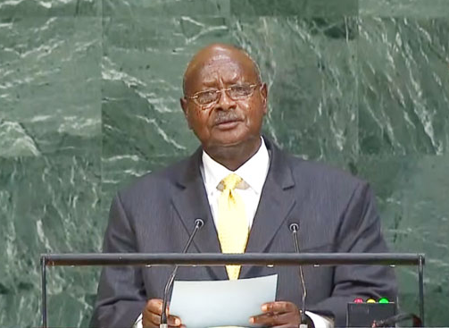


1.0 Background
As if by miracle, during the period of the 69th session of the United Nations General Assembly, the UN Member States finally agreed on all the important SDGs ─ 17 of them. The convergence of analysis and solutions, of diagnosis and prescription, is a landmark in the history of mankind. President Yoweri Kaguta Museveni Address to the UN General Assembly, New York, 28 September 2015
The SDGs, which were adopted in 2015 when Uganda held the Presidency of the UN General Assembly, Uganda has been at the fore front of SDGs. Government has since then implemented an inclusive process to ensure that the 2030 Agenda is owned by the people, starting with national coordination arrangements.
Institutional delivery on the SDGs is guided by a multi-stakeholder National SDG Coordination Framework that was established in 2016 under the leadership of the Office of the Prime Minister.
17 SDGs
169 Targets
232 Global Indicators
201 Indicators Applicable to Uganda
117 Indicators with Data Points in Uganda

Slide 4
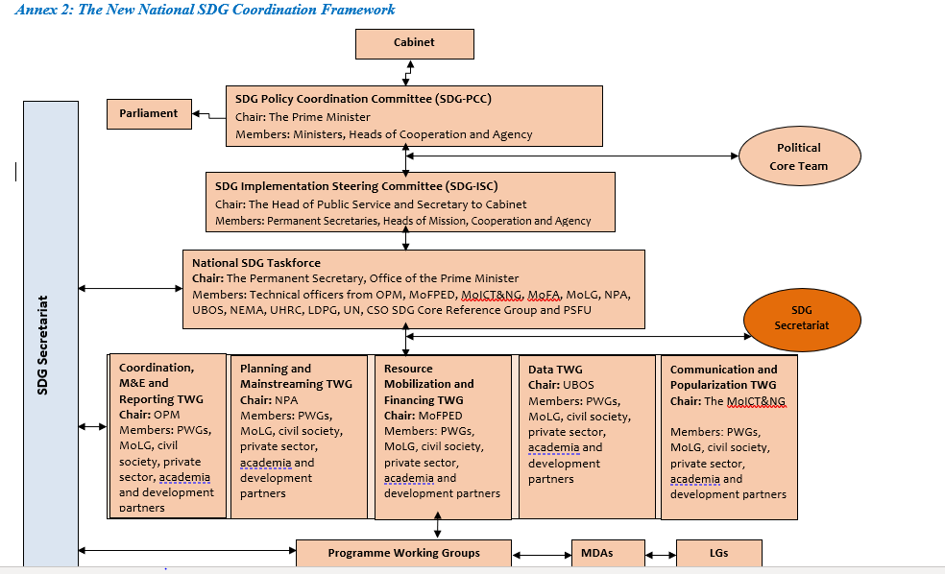
2.0 Uganda’s National SDG Coordination Framework

Slide 5
2.1 More about the National Coordination Framework
Ministries, Departments and Agencies implement SDGs through their day to day work and should all have indicators for the specific SDG targets they contribute to through ongoing activities, and ensure that all plans, budgets and activities reflects relevant SDGs.
Local Governments are at the forefront of implementing SDGs at the local level by addressing local challenges, defining priorities and solutions; and mobilizing communities to actively participate in the development process.
Parliament and Members of Parliament play a significant role in mobilizing and allocating resources, providing oversight in the implementation of the SDGs and are also advocates, mobilisers and ambassadors for the SDGs due to their closeness to people in their constituencies. In partnership with Parliamentary Forum on SDGs and oriented 320 MPs (Forum Members and committee members).
The work of non-state actors is complementary to government initiatives, and should be aligned to national development priorities. Especially, civil society actors are instrumental for the delivery on SDGs through their outreach to people in the communities, as change makers driving behavioral change, and as watchdog holding duty bearers responsible.

Slide 6
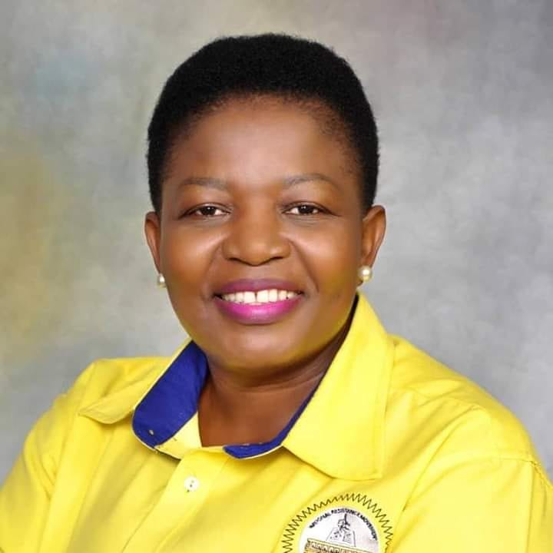

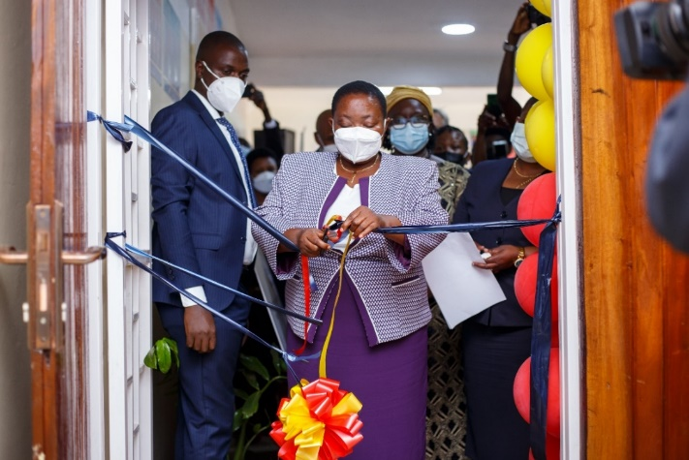
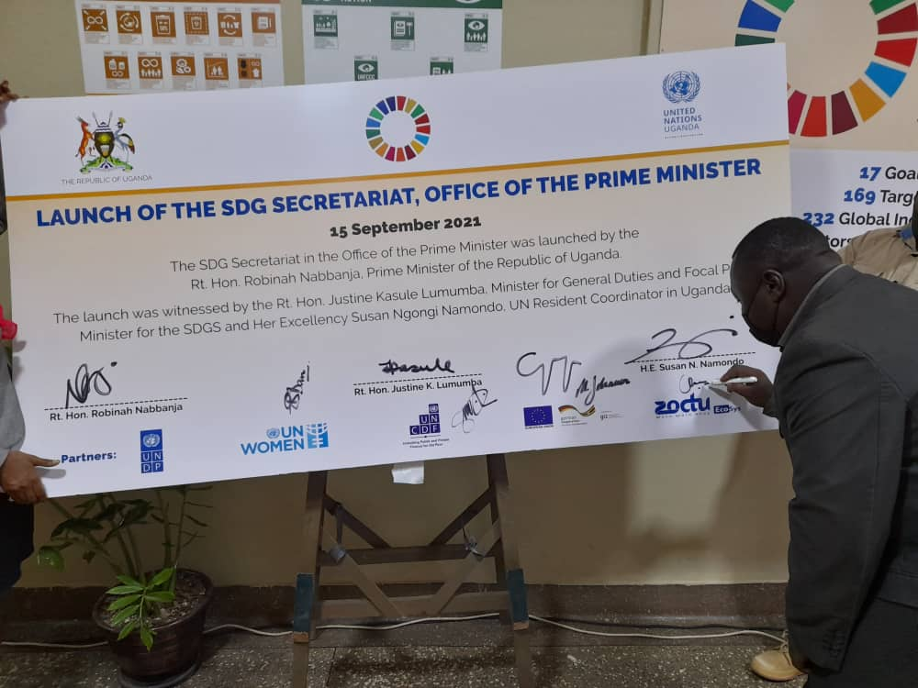
2.2 Focal Minister for SDGs & Creation of the SDG Secretariat
Focal Point Minister for SDGs
Leadership & political oversight
Presents periodic reports on SDG implementation and policy recommendations to Cabinet and chairs the Core Team of selected ministers to oversee the implementation of SDGs
Political Core Team
Chaired by the Focal Point Minister, comprises of the seven Ministers and Heads of Cooperation's
Provides the overall supervisory role in the implementation of the SDGs in Uganda and the Permanent Secretaries of these ministries are involved in providing technical advice and ensuring that SDG implementation runs smoothly
The SDG Secretariat mandated with coordinating the multi-stakeholder Framework launched in September 2021 provides;
Supporting the coordination function and providing oversight of implementation of the Coordination Framework.
Coordinating monitoring and assessment of the implementation progress of the 2030 Agenda within Government assessment structures.
Building strategic partnerships with the Private Sector on financing 8and innovation.
Providing technical support and expertise to Ministries, Departments and Agencies, Private Sector, Development Partners, Civil Society, and Academic Institutions.
Becoming the hub of SDG information and data for the Government and stakeholders.
SDG Secretariat
4

Slide 7

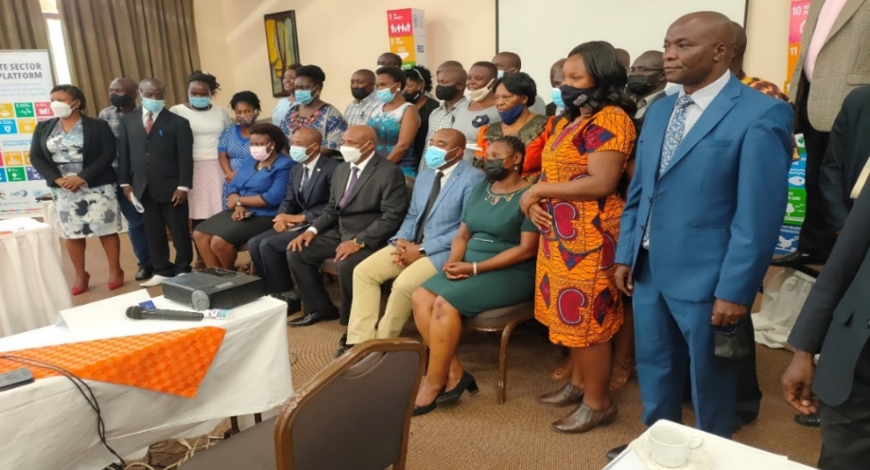
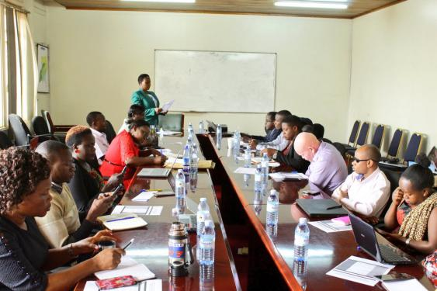
3.0 Partnership
3.1Private Sector and CSOs
Supporting the coordination structure for SDG implementation through National Task Force
The private sector has also facilitated several dialogues aimed at advancing the SDGs.
The symposium on Ethnic Minority and Indigenous Peoples came up with a number of recommendations concerning targeted monitoring and reporting through statistics on ethnic minorities by Uganda Bureau of Statistics which will improve on their inclusion in the national Planning processes.
Person with Disabilities under the leadership of the National Council for Disability, have been very instrumental in the SDG implementation in Uganda
People with Disabilities Consultations

Slide 8
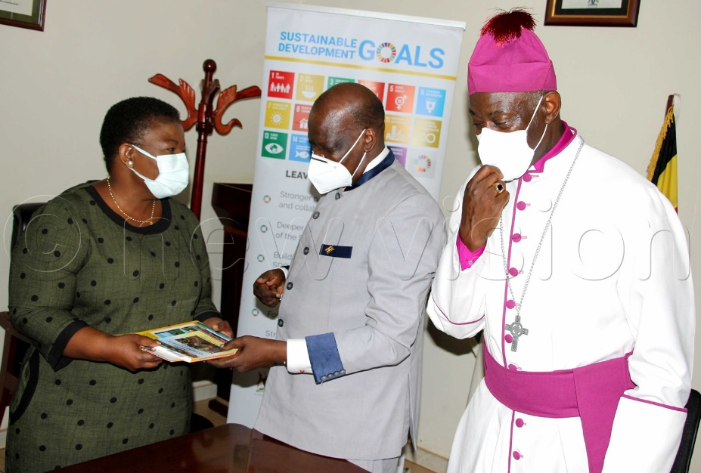
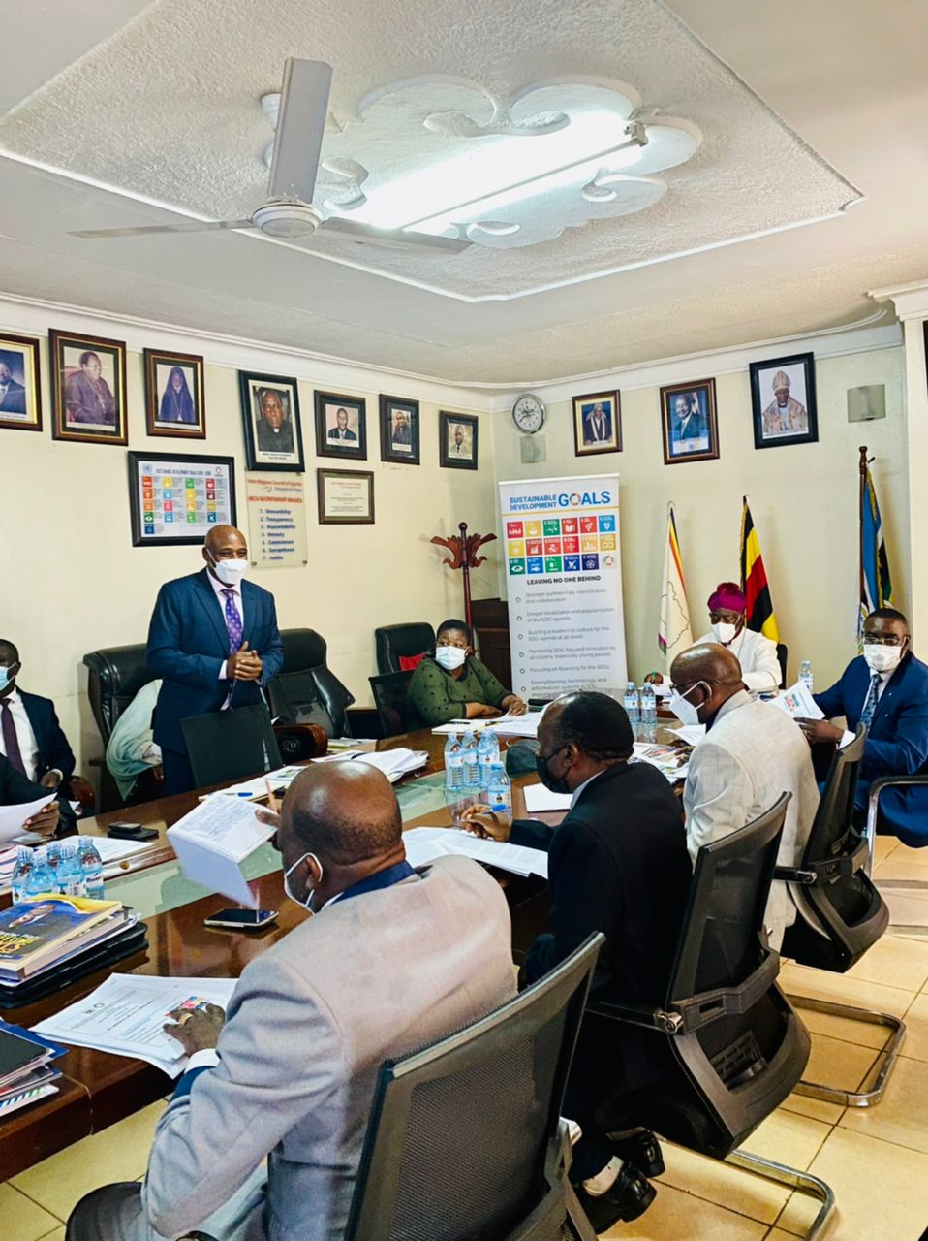
3.2 Faith Based Organisations: Inter Religious Council of Uganda
Why the Religious Leaders and SDG Localization
The acknowledgement of the served population of the important role that Faith Based Organizations play in development assistance;
Already existent participation in local, provincial, national and international advocacy scenarios;
Long-term permanence in the territory gives confidence to the local communities;
Faith Based Organizations have ability to mobilize local resources.
Above: Rt. Hon Justine K. Lumumba receiving a book during the interaction with Religious leaders
An MOU is being worked on for partnership on SDG Localization between Inter-Religious Council and Government of Uganda

Slide 9
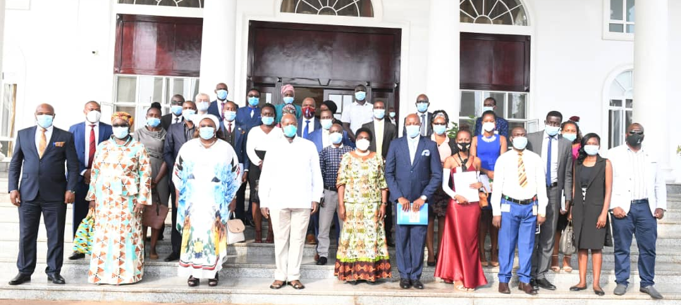
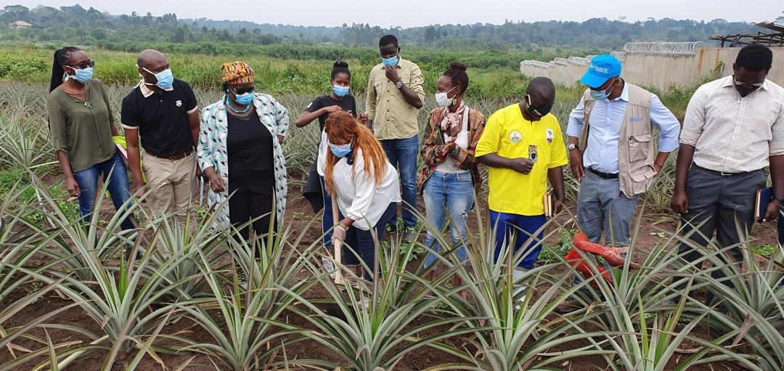
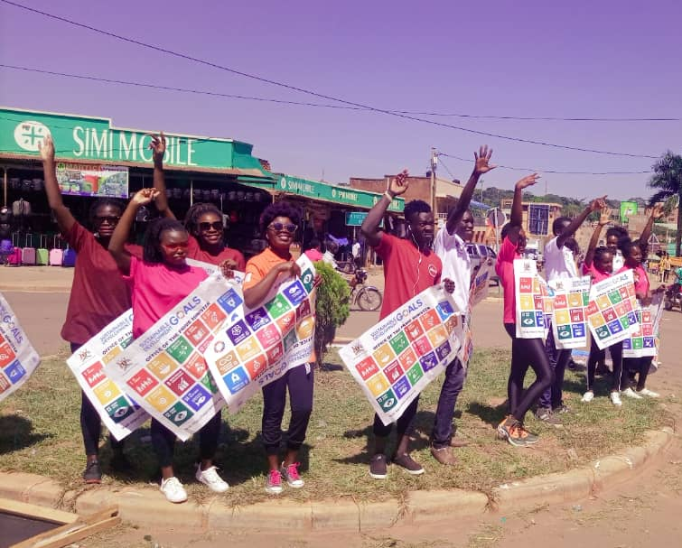
3.3 The Youth Coalition for SDGs
The Youth Coalition for SDGs, under the auspices of the SDG Secretariat, brings together more than 30 youth-led organizations and companies;
- Engagement with various groups, including at the highest Government levels, to share views & engage in SDGs implementation
- One Million SDG Solutions Innovation Challenge
- Outreach activities to raise awareness e.g. through flash mobs across the country
- Organization of events around international days to raise community awareness on SDGs
- Participation in radio and media talk shows
Youth Coalition members after a meeting with President Museveni
Youth Coalition members during a visit to the Presidential Demonstration Farm in Kawumu

Slide 10
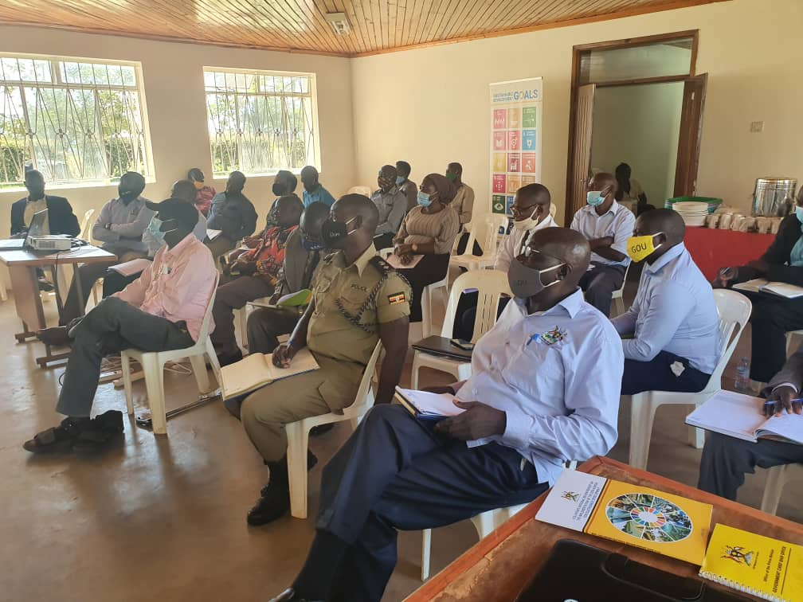
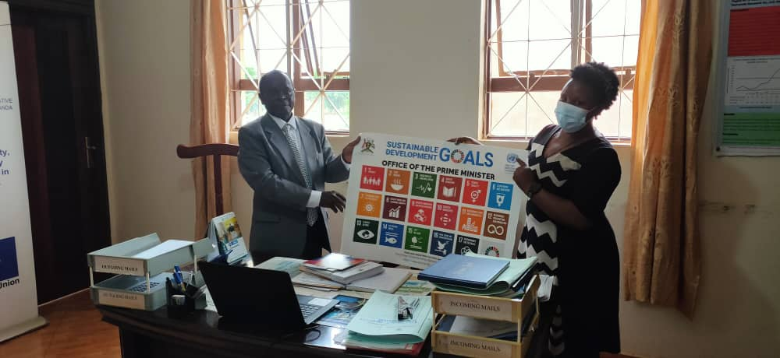
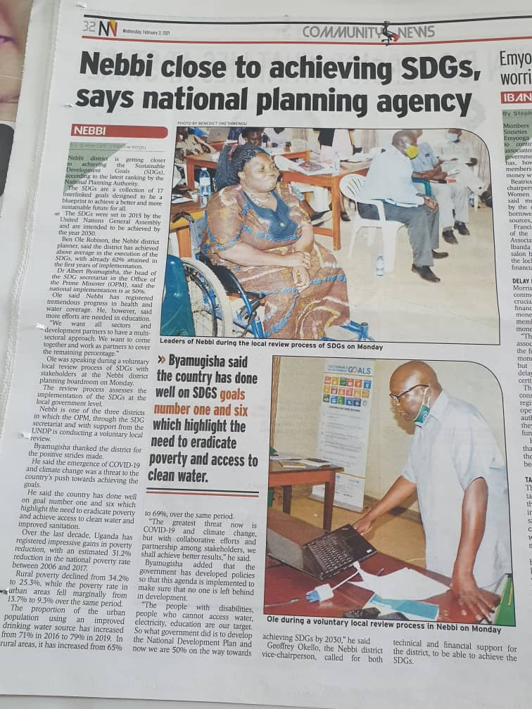
4.0 Localization of SDGs
To reach those at a risk of being left behind,
Localization and mapping of SDG champions in local Governments has been done through;
Orienting the district leadership (technical +political) on the SDGs, Uganda’s progress on the SDGs;
Roll out Voluntary Local Reviews
Dissemination of SDG materials VNR report, SDG indicator matrix, SDG posters and flyers among others (OPM)
Capacity building of district planners to integrate SDGs (NPA)
Training of District Local Governments on gender and equity planning and budgeting (Equal Opportunities Commission)

Slide 11

Thank you for listening

