Slide 1


GAMBIA

Slide 2
PRESENTATION GUIDELINES
How do you assess VNRs 2021: did they reflect special or outstanding content due to the COVID-19 pandemic?
What are the main pieces of advice to share with African countries presenting a VNR in 2022?
How can the VLRs contribute to robust and inclusive national and regional review processes?
What are key lessons learned in relation to VLRs?

Slide 3
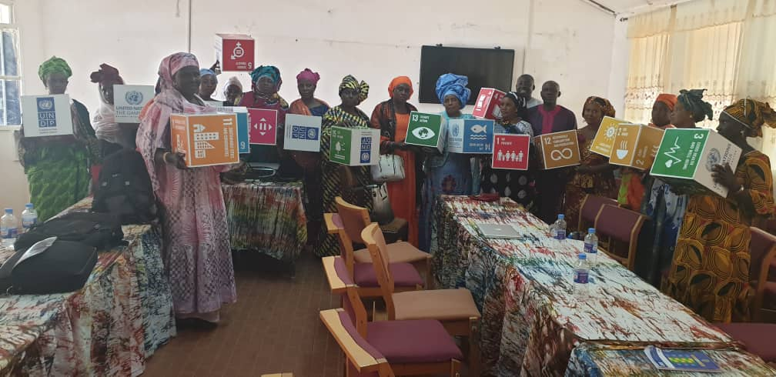
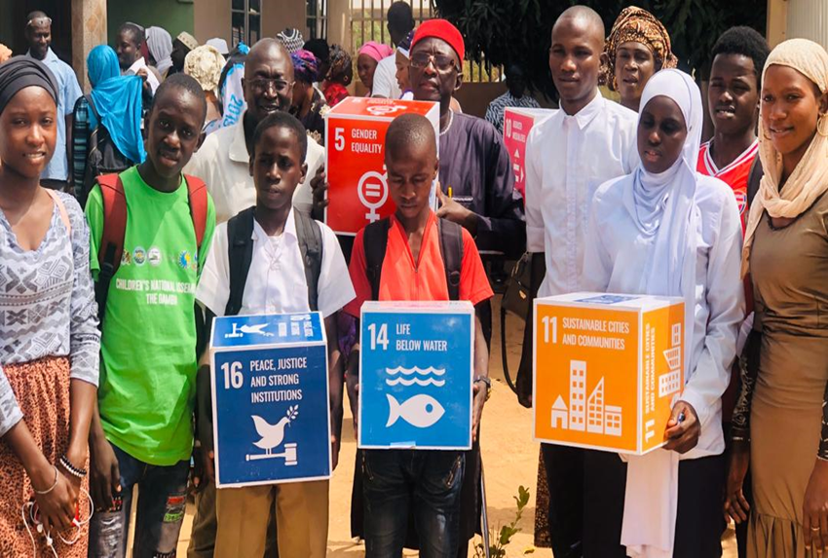
How do you assess VNRs 2021: did they reflect special or outstanding content due to the COVID-19 pandemic?

Slide 4
Introduction
As part of the government international commitment, in 2020 The Gambia was granted approval by the United Nations Economic and Social Council (ECOSOC) and submitted its first Voluntary National Review (VNR) of the Sustainable Development Goals (SDGs) to High Level Political Forum (HLPF).
To domesticate the Agenda 2030, the country formulated an NDP (2018-2021) with the overarching goal of: “[delivering] good governance and accountability, social cohesion, and national reconciliation and a revitalized and transformed economy for the wellbeing of all Gambians”.
The preparation of this first Voluntary National Review (VNR) adopted a participatory approach but the consultations were somewhat limited by COVID-19 pandemic
The outreach and consultation process ensured participation of all stakeholders; government, civil society, private sector, youths and children, women & people living with disabilities as well as development partners
Again The Gambia is among 39 countries that has been granted approval to present its second VNR in 2022.

Slide 5
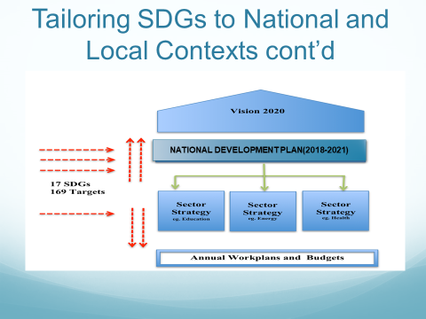
  Two rounds of prioritization done
    1st round Nov 2015: All 17 Goals and 102 targets high priority
    2nd round using MAPS: 8 Goals and 76 Targets were identified as High priority;

Slide 6
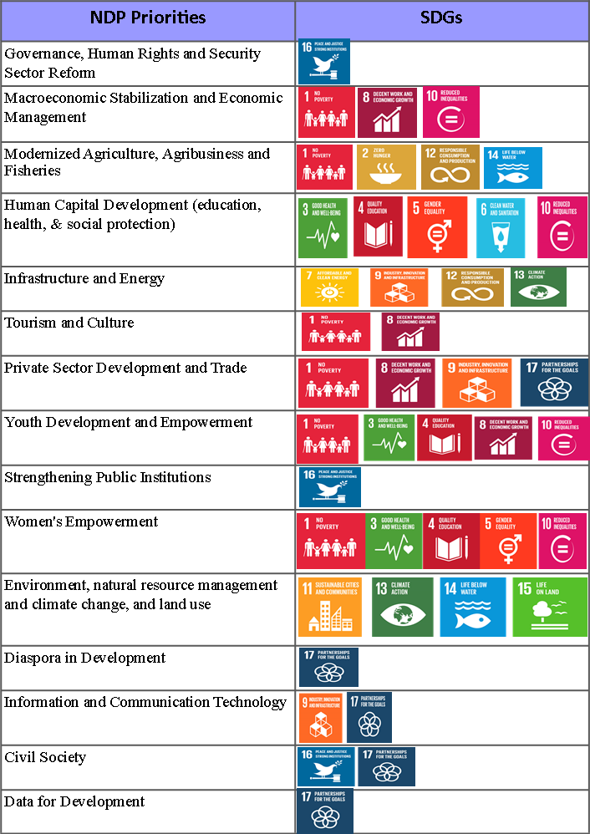
The country has a 4 year National Development Plan (NDP):2018-2021
The 8 priorities and 7 Enablers of the NDP are aligned to the SDGs
Links Between the NDP & SDGs
Progress on Goals and Targets

Slide 7
Goal 16. Promote Peaceful and Inclusive Societies for Sustainable Development, provide access to justice for all and build effective, accountable and inclusive institutions at all levels
Progress on Goals and Targets: Peace
Governance is a huge challenge for the country following 22 years of misrule which ended in 2016.
As a result, governance reforms are at the cornerstone of the country’s development agenda
Government has taken the bold step towards the institutionalization of anti-graft mechanisms through the National Assembly by tabling the Anti-Corruption and Freedom of Information bill for enactment into law
A new draft constitution submitted and gazetted
Institutional reforms include decongesting the prisons, setting up of the TRRC and the Anti-corruption commission
Unsentenced detainees as a proportion of total prison population

Slide 8
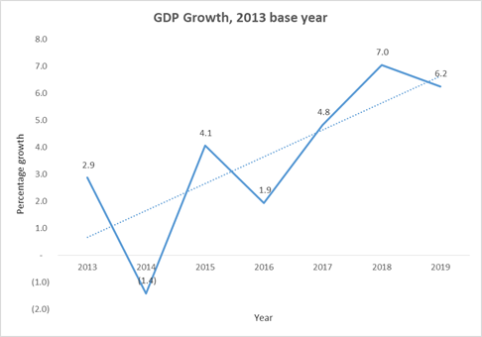
Goal 7. Ensure access to affordable, reliable, sustainable and modern energy for all
Progress on Goals and Targets: Prosperity
Goal 8. Promote sustained, inclusive and sustainable economic growth, full and productive employment and decent work for all
Government’s goal is to ensure sustainable and improved energy, petroleum, and transport sectors for a revitalized economy and well-being
Policy and regulatory environment being improved to attract investments, improve access to electricity, enhance household energy security and ensure secured petroleum resources to support national development.
The country also plans to enhance its renewable energy targets and harness the existing potentials of renewable energy
Access to electricity is still relatively low particularly in the rural areas
Economic growth driven by tourism, rain dependent agriculture, and remittances
  However, it is also highly vulnerable to external shocks
Access to electricity, National and by Place of Residence
The COVID-19 pandemic will widen the fiscal deficit from projected 1.5% to 2.1% of GDP in 2020
  An estimated GMD2.7bn
Public debt levels remain high at 89.1% of GDP in 2018 and 80.1 % in 2019
  Interest payments still accounted for 23.3% of recurrent expenditure in 2018 down from 34.5% in 2017, leaving limited fiscal space for public investment and improved service delivery

Slide 9
POST VNR CONSULTATION IN ASSESSING VNRs 2021
In assessing progress towards the implementation of SDGs Post-VNR sensitization, NDP and Covid-19 Recovery Consultations was conducted Nationally with MDAs ,National Assembly, the Private Sector, Civil Society Organisations, Federation of Disable Consultations , the Media, Academia, University of The Gambia youth and children
Similar Consultations were also held in each of the Local Government Areas (LGAs) and involved members of the Technical Advisory Committee (TAC), men, women, youth, children, differently-abled, private sector and civil society.: to get feedback from stakeholders regarding the SDG priorities and also ascertain their relevance and role and how they support and contribute to the acceleration of SDG implementation in The Gambia;
For coordinate the VNR consultations process a committee was set up which comprised of representation from the Office of The President, Ministry of Finance and Economic Affairs, UNRC in The Gambia, Resident Representative, UNDP, The National Assembly, GoBS, GCCI , The Association of Non-Governmental Organisations, Gambia Association of Local Government Authorities and the Academia, University of The Gambia (School of Arts & Sciences -dealing with SDGs issues).

Slide 10

What are the main pieces of advice to share with African countries presenting a VNR in 2022?

Slide 11
ENSURING 2022 VNR IS BUILDING ON THE ROADMAP
The 2022 VNR will build upon the 2020 VNR and update data where available on key indicators
To address data gaps during the 2020 VNR, GBoS and Government with financial support from UNDP conducted SDGs survey from 2021 - 2022 for the purpose of improving the country’s SDG indicators reporting and as well facilitates the ongoing Voluntary Reviews (VNR)
National Development Planning Platform was developed and launched as an effort to enhance online data collection.

Slide 12
VNR Process-Gambia experience
Committees Set up
Coordinating Committee
Consultations
National
Report
Drafting
Technical Working Committee
Drafting Committee
Regional
Private sectors
CSOs/CBOs
NGOs
Validation
Submission
Convergence in the membership of the VNR and VLR Steering committees to enhance synergies.
Joint VNR/VLR consultations will be held in LGAs conducting VLRs

Slide 13
IMPACT OF COVID-19
COVID-19 pandemic affected the implementation of the National Development (2018-2021) ,its spread diminished revenues and incomes, increased expenditures on often already pressured social sectors like health and education, and reduced or halted economic activities in many productive sectors.
The Gambia intends to reset its development trajectory by reprioritising its NDP into a COVID-19 recovery plan that is people-centred, resilient, green ,and leaves no one behind and will be tailored to SDGs
Policy pointer: Government and development partners are collaborating to carry out integrated and whole-of-country needs-based impact assessments (including filling data gaps) as part of the COVID-19 recovery and investment planning process.

Slide 14
Some lessons learnt in addressing the challenge and -things you may consider doing differently
The need to raise the level of awareness about the agenda 2030 and to strengthen the NSS to adequately support review of the SDGs
Increase coordination with Civil Society and NGOs to leverage their capacities as well as enhance the alignment of their interventions with the Agenda 2030.
The need for Government and stakeholders to continue engagement, advocacy, and sensitization at all levels in order to increase awareness of the SDGs.
The Government should continue to ensure the mainstreaming of the SDGs into policies and strategies at National, Sectoral and Sub-national levels
Government should continue to deepen private sector participation through sustained engagement using the existing SDG institutional arrangements and partnerships

Slide 15
Thank you for Listening

