Slide 1
Module 4 – Understanding and assessing corruption
Toolkit on Transparency, Accountability and Ethics in Public Institutions

Slide 2
Training agenda
Time | Day 1: Fundamentals of ethics and public integrity | Day 2: Ethics and public integrity at the institutional and policy level | Day 3: Organizational change for enhanced ethics and integrity | Day 4: Individual ethical behavior | Day 5: Developing a strategy, roadmap and action plan for enhanced ethics and public integrity
Morning | Module 1 - How would a world without corruption look? | Module 6 - Oversight institutions | Module 11 - Staff management and developing capacities for integrity | Module 14 - Ethical leadership | Module 18 - Preparation phase
 | Module 2 - Essentials of ethics and public integrity | Module 7 - Social accountability mechanisms | Module 12 - Creating an organizational culture of ethics and integrity | Module 15 - Assessing personal vis-à-vis organizational values
Lunch break
Afternoon | Module 3 - Transparency and accountability | Module 8 - Integrity codes | Module 13 - Transparent public procurement | Module 16 - Behavioral insights and staff incentives | Module 18 - Presentation and feedback phase
 | Module 4 - Understanding and assessing corruption | Module 9 - Managing conflict of interest |  | Module 17 - How to promote desired behavioral change?
 | Module 5 - International frameworks for integrity and anti-corruption | Module 10 - Whistleblowing

Slide 3
Module agenda
01
What is corruption?
02
Administrative corruption: Types, risk areas and impact
03
Why and how to assess corruption?
04
Practical examples of assessment tools
05
Activity: How does your country score and why so?
UN Photo/Stuart Price

Slide 4
Learning objectives
In this module you will learn:
To specify corruption and to differentiate between different types as mentioned in UNCAC;
To detect ten risk areas that are particularly prone to corruption;
To state, quantify and monetize the devastating impacts corruption can have;
To measure corruption and assess risks that it might occur, incl. the challenges in doing so;
To critically reflect on incidents and perceptions of corruption in your country.

Slide 5
Module agenda
01
What is corruption?
02
Administrative corruption: Types, risk areas and impact
03
Why and how to assess corruption?
04
Practical examples of assessment tools
05
Activity: How does your country score and why so?
UN Photo/Stuart Price

Slide 6
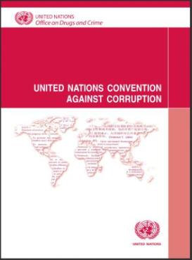
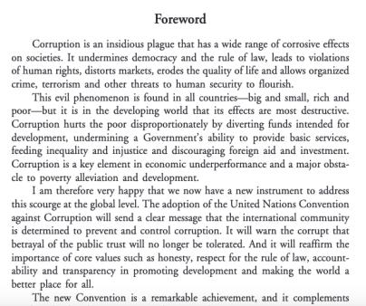
Corruption in UNCAC
No definition of corruption as such;
Listing of specific criminal offenses related to corruption (e.g. bribery, embezzlement, money laundering, concealment and obstruction of justice etc.);
Wide scope of persons that might become parties to corruption: Anyone who holds legislative, administrative, or executive office, or provides a public service, including employees of private companies under government contract.
Benefit: Coverage is not unnecessarily constrained by the details of a definition negotiated by governments at a specific time.
Notes:
Corruption in UNCAC:
UNCAC does not define corruption, since the member states could not agree on a common definition.
The implicit definition through specifying actions that count as corruption, however, point to a very broad and comprehensive understanding of the term.
Source:
United Nations Convention against Corruption. Adopted by the UN General Assembly on 31 October 2003, by resolution 58/4. Retrieved from https://www.unodc.org/documents/treaties/UNCAC/Publications/Convention/08-50026_E.pdf (last accessed on April 7, 2020).

Slide 7
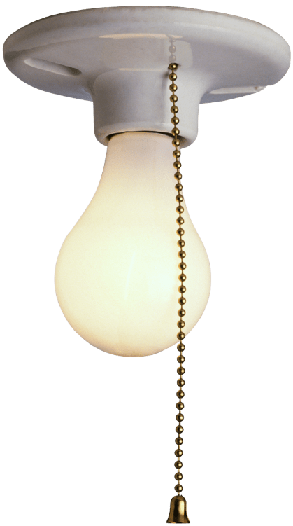
A definition by the World Bank
01
Power (public or entrusted)
– Existence of a person who is entrusted with discrectionary power.
03
Private gain
– An advantage for the entrusted person or a third-party. It may be tangible or intangible.
02
Abuse or misuse
– Violation of role/power assigned to this entrusted person.
Corruption is the abuse or misuse of public office for private gain (World Bank 1997).
Notes:
A definition by the World Bank:
Corruption is generally characterized by three elements:
Power (public or entrusted) – Existence of a person who is entrusted with discrectionary power.
Abuse – Violation of the role/power assigned to this entrusted person.
Private gain – An advantage for the entrusted person or a third-party. It may be tangible or intangible.
Definitions:
Abuse or misuse of public office for private gain (World Bank 1997);
Abuse or misuse of entrusted power for private gain (Transparency International n. y.).
Sources:
Transparency International (n. y.). What is Corruption? Retrieved from https://www.transparency.org/what-is-corruption#define (last accessed on April 8, 2020).
World Bank (1997). Helping Countries Combat Corruption. The Role of the World Bank. Retrieved from http://www1.worldbank.org/publicsector/anticorrupt/corruptn/corrptn.pdf (last accessed on April 8, 2020).

Slide 8
A formula for corruption
Corruption
Monopoly
Discretion
Accountability
Corruption can occur easily in situations where monopoly and discretion are combined without adequate accountability (Klitgaard 1988).
Notes:
Source:
Klitgaard, R. (1988). Controlling Corruption. University of California Press.

Slide 9
Module agenda
01
What is corruption?
02
Administrative corruption: Types, risk areas and impact
03
Why and how to assess corruption?
04
Practical examples of assessment tools
05
Activity: How does your country score and why so?
UN Photo/Stuart Price

Slide 10
Types of administrative corruption
1
Which criminal offenses hide behind the photos?
4
UNCAC criminalizes bribery of national public officials as well as bribery of foreign public officials and officials of public international organizations.
UNCAC criminalizes “abuse of functions or position, that is, the performance of or failure to perform an act, in violation of laws, by a public official in the discharge of his or her functions, for the purpose of obtaining an undue advantage.“
Freepik / yanalya
Freepik / katemangostar
2
3
5
UNCAC criminalizes illicit enrichment, a “significant increase in the assets of a public official that he or she cannot reasonably explain in relation to his or her lawful income.“
UNCAC criminalizes trading in influence, that is “abuse of real or supposed influence with a view to obtaining from an administration or public authority of the State Party [to the Convention] an undue advantage.“
UNCAC criminalizes the “embezzlement, misappropriation or other diversion (...) of any property, public or private funds or securities or any other thing of value entrusted to the public official by virtue of his or her position.“
Freepik / drobotdean
Freepik / master1305
Freepik / jcomp
Notes:
Types of administrative corruption:
Administrative corruption considers several conducts as corrupt. According to the United Nations Convention Against Corruption (UNCAC), administrative corruption mainly entails:
Bribery of national public officials; Bribery of foreign public officials and officials of public international organizations;
Embezzlement, misappropriation or other diversion of property by a public official (theft of state assets or diversion of state revenues);
Trading in influence;
Abuse of function;
Illicit enrichment.
Source:
United Nations Convention against Corruption. Adopted by the UN General Assembly on 31 October 2003, by resolution 58/4. Retrieved from https://www.unodc.org/documents/treaties/UNCAC/Publications/Convention/08-50026_E.pdf (last accessed on April 7, 2020).
Credits for visuals:
Freepik / drobotdean. Portrait of a smiling confident man in sunglasses. Retrieved from https://www.freepik.com/free-photo/portrait-smiling-confident-man-sunglasses_7439261.htm#page=2&query=money&position=48 (last accessed on April 7, 2020).
Freepik / jcomp. Corporate suit white man background. Retrieved from https://www.freepik.com/free-photo/corporate-suit-white-man-background_1150319.htm#page=3&query=money&position=46 (last accessed on September 8, 2020).
Freepik / katemangostar. Cropped view of business leader adjusting tie. Retrieved from https://www.freepik.com/free-photo/cropped-view-business-leader-adjusting-tie_1027074.htm#page=1&query=tie&position=41 (last accessed on September 8, 2020).
Freepik / master1305. Nahaufnahme von geschäftsleuten, die hände im konferenzraum schütteln. Retrieved from https://de.freepik.com/fotos-kostenlos/nahaufnahme-von-geschaeftsleuten-die-haende-im-konferenzraum-schuetteln_9927428.htm#page=1&query=handschlag&position=6 (last accessed on September 8, 2020).
Freepik / yanalya. Afrikanischer geschäftsmann, der umschlag mit bestechungsgeld oder geldprämie, nahaufnahme empfängt. Retrieved from https://de.freepik.com/fotos-kostenlos/afrikanischer-geschaeftsmann-der-umschlag-mit-bestechungsgeld-oder-geldpraemie-nahaufnahme-empfaengt_3955379.htm#page=1&query=bestechung&position=6 (last accessed on September 8, 2020).

Slide 11
Risk areas (1)
Decision-making procedures and leadership
Controlling and regulating activities for the general public
Bàger 2011
Notes:
Risk areas (1):
Analyzing the context where corruption takes place is fundamental for better targeted counter measures. Ten different types of activities and procedures during which corruption can arise in the public sector, emerged from the analysis of identified international policies:
1. Decision-making procedures and leadership. Decisions made for the proper functioning of a given organization. The decisions could concern both the structural mechanisms of the organization and the personnel.
2. Controlling and regulating activities for the general public refers to the delivery of licenses, issuing of permits and documents, but also tax declaration or the clearance of goods through customs.
Source:
Bàger, G (2011). Corruption Risks in Public Administration. Public Finance Quarterly, 56(1), 44-57.

Slide 12
Risk areas (2)
Delivering public utility or services
Recruitment and selection/promotion
Bàger 2011
Notes:
Risk areas (2):
3. Delivering public utility or services refers to the delivery of services to the general public such as electricity, water, medical checks, or education services.
4. Recruitment and selection/promotion in public service or government institutions.
Source:
Bàger, G (2011). Corruption Risks in Public Administration. Public Finance Quarterly, 56(1), 44-57.

Slide 13
Risk areas (3)
Contract administration
Inspection
Bàger 2011
Notes:
Risk areas (3):
5. Contract administration refers to all those activities aimed at issuing/renewing/terminating contract of public administration personnel.
6. Inspection concerns checking the compliance with laws, regulations, policies and procedures determined by public organizations among people and businesses (e.g., checking the implementation of safety at work standards).
Source:
Bàger, G (2011). Corruption Risks in Public Administration. Public Finance Quarterly, 56(1), 44-57.

Slide 14
Risk areas (4)
Management of finances
Stores management
Bàger 2011
Notes:
Risk areas (4):
7. Stores management describes the proper recording, organization, classification and control of stocks within public administration.
8. Management of finances refers to budget preparation and presentation, the public availability of information, open budget preparation, execution, and reporting, effective audit and legislature oversight.
Source:
Bàger, G (2011). Corruption Risks in Public Administration. Public Finance Quarterly, 56(1), 44-57.

Slide 15
Risk areas (5)
Cash handling
Public procurement
Bàger 2011
Notes:
Risk areas (5):
9. Cash handling concerns the management of cash money collected within a public organization.
10. Public procurement includes all activities and procedures related to procurement, from the invitation to tender to the selection of the project and award of contract.
Source:
Bàger, G (2011). Corruption Risks in Public Administration. Public Finance Quarterly, 56(1), 44-57.

Slide 16
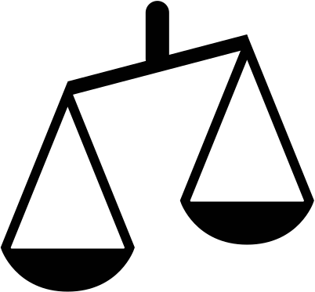
Impact (1) - Overview
Defective public interest
Persisting inequality
Slowed-down development
Reduced public sector performance
Threats to public health
Loss of people trust
Waste of public money
Corruption
Notes:
Impact (1):
Loss of people trust: If basic public services are not delivered to people due to corruption, the state eventually loses its credibility and legitimacy. As a result, disappointed people might turn away from the state, retreat from political processes, migrate – or – stand up against what they perceive to be the corrupt political and economic elites. The global uprisings from the Arab world to India, Brazil and occupy Wall Street are proving that business as usual can no longer be an option for a number of countries.
Reduced public sector performance: Corruption impacts service delivery, such as when police officers ask for bribes to perform routine services.
Persisting inequality: Empirical studies have shown that the poor pay the highest percentage of their income in bribes. For example, in Paraguay, the poor pay 12.6 percent of their income to bribes while high-income households pay 6.4 percent.
Slowed-down development: Corruption distorts market mechanisms, like fair competition and deters domestic and foreign investments, thus stifling growth and future business opportunities for all stakeholders. IMF research has shown that investment in corrupt countries is almost 5% less than in countries that are relatively corruption-free. The World Economic Forum estimates that corruption increases the cost of doing business by up to 10% on average.
Threats to public health: For example, counterfeit drugs or vaccinations impact health of populations. For example, child mortality rates in countries with high levels of corruption are about one third higher than in countries with low corruption, infant mortality rates are almost twice as high and student dropout rates are five times as high.
Waste of public money: The African Union (2002) estimates that 25% of the GDP of African states, amounting to US$148 billion, is lost to corruption every year. Investments are not allocated to sectors and programmes which present the best value for money or where needs are highest, but to those which offer the best prospects for personal enrichment.
Text of UNCAC preamble: “...concerned about the seriousness of problems and threats posed by corruption to the stability and security of societies, undermining the institutions and values of democracy, ethical values and justice and jeopardizing sustainable development and the rule of law“.

Slide 17
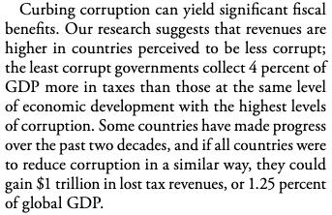
Impact (2) - Waste of public money
Mauro et al. 2019
Notes:
Source:
Mauro, P., Medas, P. & Fournier, J.-M. (September 2019). The Cost Of Corruption. Finance & Development, 56(3). Retrieved from https://www.imf.org/external/pubs/ft/fandd/2019/09/pdf/the-true-cost-of-global-corruption-mauro.pdf (last accessed on June 10, 2020).

Slide 18
Impact (3) - Loss of people trust
High levels of perceived corruption
reduce confidence in government!
OECD 2017
Notes:
Impact (3) - Loss of people trust:
The slide illustrates the correlation between trust in government and level of corruption. Data has been taken from OECD countries.
The data clearly indicates how the perception of high levels of corruption reduces the trust and confidence in government.
Source:
OECD (2017). Government at a glance 2017. Retrieved from https://www.oecd-ilibrary.org/sites/gov_glance-2017-en/index.html?itemId=/content/publication/gov_glance-2017-en (last accessed on April 7, 2020).

Slide 19
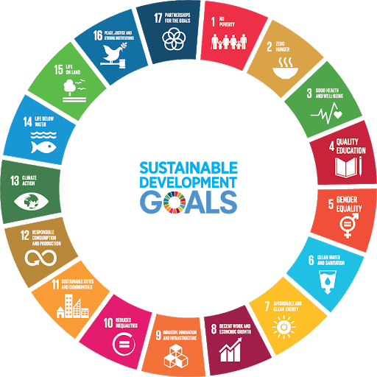
Impact (4) - SDGs at risk
Embezzlement of funds during and after the procurement process is an area of concern across sectors, especially in sectors where a lot of money, specialized equipment and complex organizational structures create opportunities for corruption,such as in health and education.
At the policy-making level, corruption manifests itself in two major forms: grand corruption and undue influence for personal gain exercised by interest groups over the formulation of laws and regulations.
Corruption in service delivery at the client interface most frequently takes the form of bribery (Transparency International April 2017).
At the administrative level, the management of organizational resources, such as personnel, goods, supplies and budgets, can be vulnerable to discretionary abuse, misappropriation and unethical practices, such as patronage and nepotism.
Notes:
Impact (4) - SDGs at risk:
Corruption represents a major obstacle to reaching many of the SDGs by hampering economic growth and increasing poverty in terms of income inequality, access to services and resource distribution.
In addition, corruption occurs at every stage of the service delivery chain, from policy design and budgetary allocations to procurement and bribery, thereby undermining the quantity and quality of public services and restricting access to quality health, water and education services, with a disproportionate impact on the poor.
As witnessed during the implementation of the millennium development goals, positive outcomes in the short term will not be sustained over the longer term if corrupt practices go unabated.
At the policy-making level, corruption manifests itself in two major forms: grand corruption and undue influence for personal gain exercised by interest groups over the formulation of laws and regulations;
At the administrative level, the management of organizational resources, such as personnel, goods, supplies and budgets, can be vulnerable to discretionary abuse, misappropriation and unethical practices, such as patronage and nepotism;
Embezzlement of funds during and after the procurement process is an area of concern across sectors, especially in sectors where a lot of money, specialized equipment and complex organizational structures create opportunities for corruption,such as in health and education;
Corruption in service delivery at the client interface most frequently takes the form of bribery.
Source:
Transparency international (April 2017). Monitoring corruption and anti-corruption in the Sustainable Development Goals: A resource guide. Retrieved from https://www.transparency.org/whatwedo/publication/monitoring_corruption_and_anti_corruption_in_the_sustainable_development_go (last accessed on April 7, 2020).

Slide 20
Module agenda
01
What is corruption?
02
Administrative corruption: Types, risk areas and impact
03
Why and how to assess corruption?
04
Practical examples of assessment tools
05
Activity: How does your country score and why so?
UN Photo/Stuart Price

Slide 21
Why is corruption assessed?
Creating peer-pressure
Preparing evidence-based corruption intervention
Raising awareness
Recording improvements (or aggravation) over time
UNODC 2018
Notes:
Why is corruption assessed?
The collection of reliable, comprehensive and comparable data on corruption at national level is fundamental for monitoring trends in corruption and for understanding its patterns and drivers.
Raising awareness: Data on corruption is a useful way of grasping the scope of the problem and identify areas of risk. It also makes corruption more tangible, thus making it easier to put on the political agenda;
Creating peer-pressure: Comparative studies contextualize corruption by e.g. comparing bribery rates in different countries around the globe. Ideally, this can inspire a raise to the topic, in which countries seek to improve their ratings;
Preparing evidence-based corruption intervention: Corruption measurement is also an effective way of curbing corruption, since it allows to target specific, pre-determined risk areas or monitor the effectiveness of anti-corruption reforms through impact analysis;
Recording improvements (or aggravation) over time: Corruption data that for instance indicates that corruption reforms work, can help sustain political will throughout the reform period. E.g. appropriate assessment allows to record improvement towards the achievement of the SDGs.
Each reason mentioned can also be seen in a wider cyclic process of continuous improvement.
Source:
United Nations Office on Drugs and Crime (2018). Manual On Corruption Surveys. Methodological guidelines on the measurement of bribery and other forms of corruption through sample surveys. Austria: Vienna International Centre. Retrieved from https://www.unodc.org/documents/data-and-analysis/Crime-statistics/CorruptionManual_2018_web.pdf (last accessed on April 17, 2020).

Slide 22
Monitoring and evaluation
Monitoring and evaluation
Crucial ingredients to increase knowledge on what works and what does not;
Requires looking at different tools, techniques and methods depending on what is going to be measured;
No single formula or one-fits-all approach to unravel the complexity of the issues.
Compliance tests
Investigation whether institutions have adequate rules and procedures in place and whether they work and are are adhered to. Examples of specific indicators:
Reporting rates to public authorities of cases of bribery to public servants and potential follow-up actions;
Requests for information submitted to and answered by public authorities; or
Announcements related to public procurement procedures (e.g. contract award notices, if accessible).
Freepik / asierromero
UNDP 2018
Notes:
Monitoring and evaluation:
Corruption measurement/assessment and anti-corruption monitoring and evaluation are crucial ingredients to increase our knowledge on what works and what does not in the fight against corruption.
To be effective anti-corruption programs must be based on a sound foundation of corruption risk assessments or measurement of the extent that corruption has permeated the public and private institutions.
However, the issue of corruption measurement and anti-corruption monitoring and evaluation requires looking at different tools, techniques, and methods depending on what is going to be measured.
There is no single formula or one-fits-all approach that will unravel the complexity of these issues.
Compliance tests:
Investigation whether institutions have adequate rules and processes in place and whether they work and are are adhered to. Examples of specific indicators that capture (anti-)corruption:
Reporting rates to relevant public authorities (e.g. the police, anti-corruption agencies) of cases of bribery to public servants and reporting on the extent to which cases are potentially followed-up by public authorities;
Information requests submitted by civil society organizations who then record details about timing delays, quality of responses, ease of appeals processes, and so on; or
Concerning public procurement procedures, comparison of rules, procedures and request prior to the award of a contract (e.g. public procurement law, invitation to tender, terms of reference) with results of the procurement procedure (e.g. contract award notice (if accessible)) and subesquent delivery.
Source:
United Nations Development Programme (2018). Anti-Corruption Measurement and Monitoring. Retrieved from http://www.anti-corruption.org/themes/corruption-measurement-anti-corruption-monitoring/ (last accessed on April 17, 2020).
Credits for visuals:
Freepik / asierromero. Man looking through a magnifying glass. Retrieved from https://www.freepik.com/free-photo/man-looking-through-magnifying-glass_908521.htm#page=2&query=magnifying&position=42 (last accessed on April 17, 2020).

Slide 23
Approaches to corruption measurement
Issues:
Absence of a unanimously agreed upon definition: It encompasses a great variety of legal and illegal behaviours which can rarely be measured directly by a single indicator;
Unobservable phenomenon: It has an informal and hidden nature;
Low reporting rates, e.g. due to crime-like character, fears of retaliation, distrust in the system or personal involvement (UNODC 2018).
Key terms:
Rules-based indicators of corruption measure whether countries have legislation prohibiting corruption or have an anticorruption agency (often used to measure accountability);
Outcomes-based indicators of corruption assess whether the laws are enforced or the anticorruption agency is undermined by political interference;
Experienced corruption refers to people’s direct experience with or participation in corruption, that is concrete incidents of corruption;
Perceived corruption concerns the level or the amount of corruption an individual believes to exist (Kaufmann & Kraay 2008; Morris 2008).
Corruption measurement
Rules-based indicators
Outcomes-based indicators
Experience
Expert opinions
Perception
Official statistics
Surveys
Sources of information
Notes:
Approaches to corruption measurement:
Issues:
The measurement of corruption is challenging. Corruption is a crime and collecting accurate data on it is at least as challenging as gathering evidence on any other type of crime. Illicit behaviour is hidden and victims are not always willing or able to report it to the authorities.
For reasons such as the fear of retaliation, reluctance to resist an established practice or because they feel to some extent co-responsible, those who experience corruption are even less prone to report the crime to competent authorities than the victims of other crimes.
When the measurement of corruption began, the difficulty of collecting relevant evidence favored the use of indirect approaches, in which the measurement is not based on the occurrence of the phenomenon of interest but on other methods of assessment.
Key terms:
Rules-based indicators of corruption measure whether countries have legislation prohibiting corruption or have an anticorruption agency (often used to measure accountability);
Outcomes-based indicators of corruption assess whether the laws are enforced or the anticorruption agency is undermined by political interference. E.g. Doing Business project and Database of Political Institutions – World Bank; Global Integrity Index (Kaufmann & Kraay 2008);
Experienced corruption refers to people’s direct experience with or participation in corruption (Morris 2008);
Perceived corruption concerns the level or the amount of corruption an individual believes to exist (Morris 2008).
Sources:
Kaufmann, D. & Kraay, A. (January 2008). Governance Indicators: Where Are We, Where Should We Be Going? Published by Oxford University Press on behalf of the International Bank for Reconstruction and Development / The World Bank. Retrieved from https://mpra.ub.uni-muenchen.de/8212/1/MPRA_paper_8212.pdf (last accessed on April 19, 2008).
Morris, S. D. (2008). Disaggregating Corruption: A Comparison of Participation and Perceptions in Latin America with a Focus on Mexico. Bulleting of Latin American Research, 27(3), 388-409. Retrieved from https://onlinelibrary.wiley.com/doi/abs/10.1111/j.1470-9856.2008.00276.x (last accessed on April 19, 2008).
United Nations, Office on Drugs and Crime (2018). Manual On Corruption Surveys. Methodological guidelines on the measurement of bribery and other forms of corruption through sample surveys. Austria: Vienna International Centre. Retrieved from https://www.unodc.org/documents/data-and-analysis/Crime-statistics/CorruptionManual_2018_web.pdf (last accessed on April 17, 2020).

Slide 24
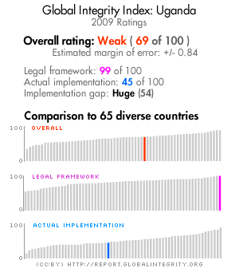
De jure versus de facto indicators
A common distinction in corruption measurement is the measurement of anti-corruption measures in law (de jure) versus in practice (de facto):
De jure indicators refer to laws, policies, operating procedures and/or administrative regulations that assign responsibilities and authority to act;
De facto indicators refer to the implementation of the de jure framework, or what happens “in practice” when laws and policies are enforced, for example outputs and outcomes;
De jure data clarifies the mechanisms in place to prevent corruption or to sanction corrupt behaviour, while de facto data reveals whether these mechanisms are succeeding and in what ways;
Implementation gap: The combination of de jure and de facto indicators and can point to a gap, i.e. laws might be strong and meet standards on paper, but their implementation is poor and thus do not achieve the desired change (UNDP 2015: 52-53).
The implementation gap
Country X
CIPE / Global Integrity 2012
Notes:
De jure versus de facto indicators:
De jure indicators: These rules consist of laws, policies, operating procedures and/or administrative regulations that assign responsibilities and authority to act.
De facto indicators: The term de facto refers to the implementation of the de jure framework, or what happens “in practice” when laws and policies are enforced, for example outputs and outcomes.
De jure data clarifies the mechanisms that are in place to prevent corruption or to sanction corrupt behaviour, while de facto data reveals whether these mechanisms are succeeding and in what ways.
Implementation gap: The combination of de jure and de facto indicators and can point to a gap, i.e. laws might be strong and meet standards on paper, but their implementation is poor and thus do not achieve the desired change.
Sources:
Center for International Private Enterprise (CIPE) / Global Integrity (2012). Improving Public Governance. Closing the Implementation Gap between Law and Practice. Retrieved from https://www.cipe.org/wp-content/uploads/2012/10/GI-CIPE_Implementation-Gap_for-web.pdf (last accessed on April 17, 2020).
United Nations Development Programme (September 2015). Users’ Guide to Measuring Corruption and Anti-corruption. Global Anti-corruption Initiative. Retrieved from https://issuu.com/undpasiapacific/docs/users-guide-measuring-corruption-an/53 (last accessed on April 17, 2020).

Slide 25
Relevant SDG 16 indicators
Targets | Indicators
16.4 Significantly reduce illicit financial and arms flows, strengthen the recovery and return of stolen assets and combat all forms of organized crime | 16.4.1: Total value of inward and outward illicit financial flows (in current United States dollars). 16.4.2: Proportion of seized, found or surrendered arms whose illicit origin or context has been traced or established by a competent authority in line with international instruments.
16.5 Substantially reduce corruption and bribery in all their forms ​ | 16.5.1: Proportion of persons who had at least one contact with a public official and who paid a bribe to a public official, or were asked for a bribe by those public officials, during the previous 12 months. ​ 16.5.2: Proportion of businesses that had at least one contact with a public official and that paid a bribe to a public official, or were asked for a bribe by those public officials during the previous 12 months.
16.6 Develop effective, accountable and transparent institutions at all levels ​ | 16.6.1: Primary government expenditures as a proportion of original approved budget, by sector (or by budget codes or similar). ​ 16.6.2: Proportion of the population satisfied with their last experience of public services.
16.10 Ensure public access to information and protect fundamental freedoms, in accordance with national legislation and international agreements | 16.10.1: Number of verified cases of killing, kidnapping, enforced disappearance, arbitrary detention and torture of journalists, associated media personnel, trade unionists and human rights advocates in the previous 12 months. 16.10.2: Number of countries that adopt and implement constitutional, statutory and/or policy guarantees for public access to information.
Notes:
Source:
United Nations (2021). Global indicator framework for the Sustainable Development Goalsand targets of the 2030 Agenda for Sustainable Development. A/RES/71/313. Retrieved from https://unstats.un.org/sdgs/indicators/Global%20Indicator%20Framework%20after%202021%20refinement_Eng.pdf (last accessed on April 7, 2021).

Slide 26
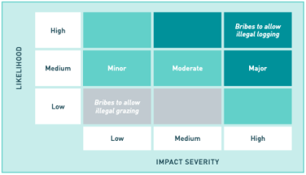
Corruption risk assessments
Objectives:
Identifying weaknesses and vulnerabilities in a system which may present opportunities for corruption to occur;
Focussing on the potential for - rather than the perception, existence or extent of - corruption;
Evaluating likelihood of corruption occurring in combination with the impact it would have should it occur;
Prioritizing corruption risks in a corruption risk matrix to inform what preventive action needs to be taken to mitigate the most critical risks (UNODC 2020: 22).
Can provide useful general overview and guidance based on consensus of expert opinions; Do not require too many resources and a lot of existing information can be used (Messick 2018). | Both estimate on likelihood and impact need to be accurate to avoid harm; Lack of clarity as to how judgments are made; Risk of consensus based on group pressure to conform; Bias to overestimate events one has experienced in real-life and to underestimate what is remote in space and time and unknown.
Notes:
Corruption risk assessment:
The results of a risk assessment can be presented in a number of ways. In some cases, risks are visualized through a corruption risk map which highlights key stages, actors and/or relationships in the process under analysis.
Another visual tool is the corruption risk matrix which is often used to prioritize risks (see figure on slide). More often than not however, results are either presented in tabular form or as a checklist. Where the risk assessment is part of a broader risk management framework, these inform what preventive action needs to be taken to mitigate the most critical risks.
Sources:
Messick, R. (January 2018). Corruption Risk Assessments: Am I Missing Something? GAB | The Global Anticorruption Blog. Retrieved from https://globalanticorruptionblog.com/2018/01/03/corruption-risk-assessments-am-i-missing-something/ (last accessed on April 17, 2020).
United Nations Office on Drugs and Crime (2020). State of Integrity. A Guide on Conducting Corruption Risk Assessments in Public Organizations. Retrieved from https://www.unodc.org/documents/corruption/Publications/2020/State_of_Integrity_EN.pdf (last accessed on April 1, 2021).

Slide 27
Module agenda
01
What is corruption?
02
Administrative corruption: Types, risk areas and impact
03
Why and how to assess corruption?
04
Practical examples of assessment tools
05
Activity: How does your country score and why so?
UN Photo/Stuart Price

Slide 28
Three generations of assessment tools
Most widely known;
Reliance on surveys that measure expert and people’s perceptions of the prevalence and nature of corruption.
Directly measuring corruption with victimization surveys and bureaucratic quality indicators (e.g. tax collection efficiency or fiscal transparency) to move from perceptions to more objectivity.
Criticism:
Like the first generation, reliance on perceptions which may be subjective and sticky;
Private providers of indices with intransparent methodologies and data sources;
Poor governance could mean bureaucratic capacity gaps, not necessarily corruption.
Context: Spread of internet usership, computing power, big data and access to publicly available databases;
Adopt less subjective, transparent and reproducible methodological approach;
Example: Procurement analyses to identify contractual outliers and politically-motivated shifts in the awarding of contracts (Malito 2014).
1st-generation measures of corruption
2nd-generation measures of corruption
3rd-generation measures of corruption
Notes:
Three generations of assesment tools:
The first-generation measures of corruption — and most widely known — relied on surveys that measure expert and people’s perceptions of the prevalence and nature of corruption.
To move from perceptions to more objective measures of corruption, a second generation of measures tried to directly measure corruption with victimization surveys and bureaucratic quality indicators (e.g. tax collection efficiency or fiscal transparency). While such measures offer insight on the nature and extent of corruption across countries, especially when used in tandem, they also fall prey to several critiques: like the first generation, they too rely on perceptions, which are subjective and sticky; some private providers of governance indicators are not transparent about their methodologies; and indicator-based measures may reflect differences amongst countries in bureaucratic capacity, not corruption. Second generational indicator-based measures may reflect capacity gaps, not actual corruption. While indicator-based measures improve on perception-based measures by being more objective, they suffer from an identification problem since it is not immediately clear that poor government performance is driven by corruption or simply reflects low capacity within the government agency.
Over the past decade, increasing access to large databases and the exponential spread of internet usership have ushered in a third generation of measures of corruption unified by their use of big data. Examples of such measures include India’s IPaidABribe.com and procurement analyses that identify contractual outliers and politically-motivated shifts in the awarding of government contracts. Third generation measures adopt a less subjective, transparent, and reproducible methodological approach; they do not rely on a select group of experts to assess the level and nature of corruption; and they provide a higher frequency, less sticky indicator.
Source:
Malito, D. (February 2014). Measuring Corruption Indicators and Indices. Robert Schuman Centre for Advanced Studies Research Paper 2014/13. Retrieved from https://papers.ssrn.com/sol3/papers.cfm?abstract_id=2393335 (last accessed on April 17, 2020).

Slide 29
World Bank’s Worldwide Governance Indicators
Worldwide Governance Indicators n. y.; Kaufmann et al. 2010
Notes:
World Bank’s Worldwide Governance Indicators:
The Worldwide Governance Indicators (WGI) are a research dataset summarizing the views on the quality of governance provided by a large number of enterprise, people and expert survey respondents in industrial and developing countries. These data are gathered from a number of survey institutes, think tanks, non-governmental organizations, international organizations, and private sector firms. The WGI report on six broad dimensions of governance for over 200 countries and territories over the period 1996-2018:
Voice and Accountability;
Political Stability and Absence of Violence;
Government Effectiveness;
Regulatory Quality;
Rule of Law; and
Control of Corruption.
Follow the links above for a definition of each of the six dimensions of governance, and a list of the individual indicators on which each aggregate indicator is based.
The WGI are composite governance indicators based on over 30 underlying data sources. These data sources are rescaled and combined to create the six aggregate indicators using a statistical methodology known as an unobserved components model. A key feature of the methodology is that it generates margins of error for each governance estimate. These margins of error need to be taken into account when making comparisons across countries and over time.
The six composite WGI measures are useful as a tool for broad cross-country comparisons and for evaluating broad trends over time. However, they are often too blunt a tool to be useful in formulating specific governance reforms in particular country contexts. Such reforms, and evaluation of their progress, need to be informed by much more detailed and country-specific diagnostic data that can identify the relevant constraints on governance in particular country circumstances.
The WGI are complementary to a large number of other efforts to construct more detailed measures of governance, often just for a single country. Users are also encouraged to consult the disaggregated individual indicators underlying the composite WGI scores to gain more insights into the particular areas of strengths and weaknesses identified by the data.
The WGI are a research dataset initiated by Daniel Kaufmann (Natural Resource Governance Institute and Brookings Institution) and Aart Kraay (World Bank Development Research Group) in 1999. Pablo Zoido and Massimo Mastruzzi also made major contributions to the development and updating of the WGI.
The WGI do not reflect the official views of the Natural Resource Governance Institute, the Brookings Institutions, the World Bank, its Executive Directors, or the countries they represent. The WGI are not used by the World Bank Group to allocate resources.
Note for trainers: Consider extracting country specific data from the WGI database in preparation for a training to make results more tangible and provide basis for discussion. Data can be extracted here: http://info.worldbank.org/governance/wgi/#reports. For a full description of the WGI methodology, click here.
Sources:
Kaufmann, D., Kraay, A. & Mastruzzi, M. (September 2010). The Worldwide Governance Indicators. Methodology and Analytical issues. World Bank Policy Research Working Paper No. 5430. Retrieved from https://papers.ssrn.com/sol3/papers.cfm?abstract_id=1682130 (last accessed on April 19, 2020).
Worldwide Governance Indicators (n. Y.). Interactive Data Access. Retrieved from http://info.worldbank.org/governance/wgi/Home/Reports (last accessed on April 19, 2020).

Slide 30
Transparency International‘s Corruption Perceptions Index
Transparency International January 2020
Notes:
Transparency International‘s Corruption Perceptions Index:
Transparency International‘s Corruption Perceptions Index (CPI) scores and ranks 180 countries/territories based on how corrupt a country’s public sector is perceived to be by experts and businesspeople.
It uses a scale of zero to 100, where zero is highly corrupt and 100 is very clean.
Like previous years, more than two-thirds of countries score below 50 on this year’s CPI, with an average score of just 43. The data shows that despite some progress, most countries still fail to tackle corruption effectively.
In addition to earning poor scores, nearly half of all countries have been stagnant on the CPI for almost a decade. These countries have failed to move the needle in any significant way to improve their score and combat public sector corruption.
Source:
Transparency International (January 2020). Corruption Perceptions Index 2020. Retrieved from https://images.transparencycdn.org/images/CPI2020_Report_EN_0802-WEB-1_2021-02-08-103053.pdf (last accessed on April 17, 2020).

Slide 31
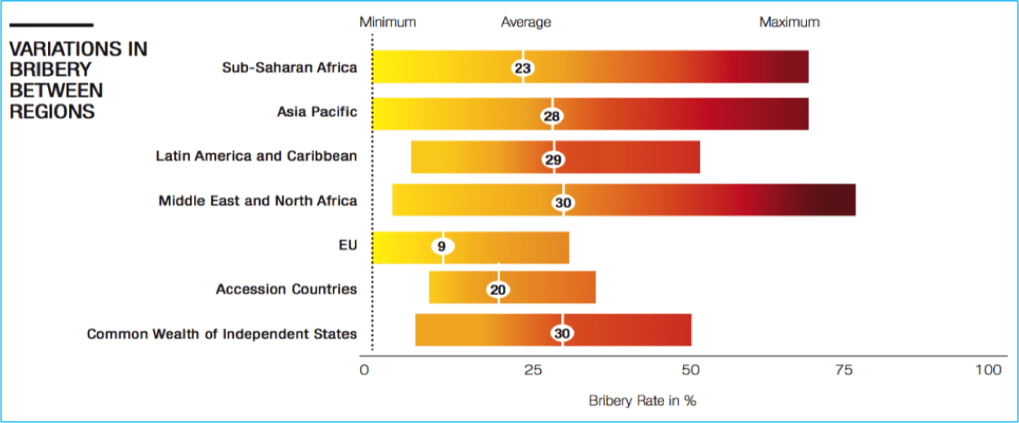
Transparency International‘s Global Corruption Barometer
Transparency International 2017
Notes:
Transparency International‘s Global Corruption Barometer:
Transparency International’s Global Corruption Barometer (GCB) is a survey of the general public, which captures the experience that ordinary people have of paying bribes for local services as well as their perceptions of corruption.
The survey has been conducted since 2003 and is now the largest cross-continental public opinion survey focusing on bribery and corruption.
The survey sample in each country is approximately one thousand people.
Depending on the country context, interviews are conducted either face-to-face, by telephone or online surveys.
Unlike most other indices, the GCB allows for disaggregation of data by gender, income, age group, and urban/rural residence.
Specifically, the survey provides information on:
• Which countries report high or low levels of petty bribery;
• Which sectors/institutions are considered most affected by corruption;
• Attitudes towards the government’s effectiveness in fighting corruption;
• Attitudes towards reporting corruption; and
• Attitudes on what sort of behaviour constitutes corruption.
The 2017 survey asked people about their direct experiences of bribery in the 12 months prior to when the survey took place. Bribery is a common form for administrative corruption and serves thus as a useful indicator.
In Asia Pacific, Latin America and the Caribbean, Africa and the Middle East, people were asked whether they had paid a bribe for any of six services which they may have had contact with. In Europe and Central Asia they were asked whether their household had paid a bribe for any of eight public services.
Source:
Transparency International (November 2017). Global Corruption Barometer: citizens’ voices from around the world. Retrieved from https://www.transparency.org/news/feature/global_corruption_barometer_citizens_voices_from_around_the_world (last accessed on April 7, 2020).

Slide 32
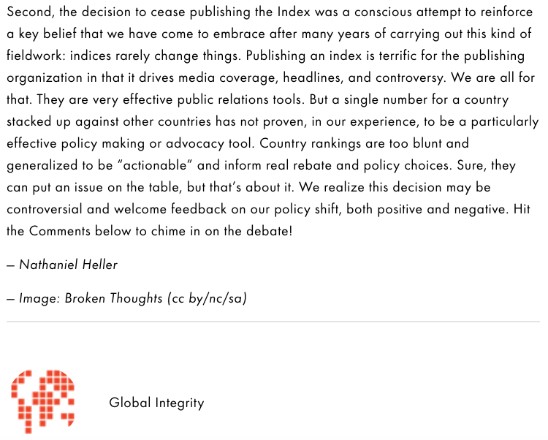
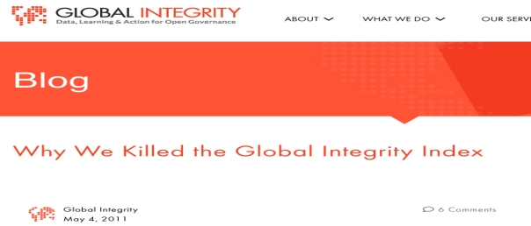
Challenges with ratings and rankings
Heller 2011
Notes:
Source:
Heller, N. (May 2011). Why We Killed the Global Integrity Index. Global Integrity Blog. Retrieved from https://www.globalintegrity.org/2011/05/04/post-792/ (last accessed on June 10, 2020).

Slide 33
Module agenda
01
What is corruption?
02
Administrative corruption: Types, risk areas and impact
03
Why and how to assess corruption?
04
Practical examples of assessment tools
05
Activity: How does your country score and why so?
UN Photo/Stuart Price

Slide 34
Activity
UN Photo/Mark Garten

Slide 35
How does your country score and why so?
Why?
The purpose of this activity is to critically reflect on the incidence of corruption in your country on paper and in practice, as well as on the validity of international (anti-corruption) ratings and rankings.
What?
Based on an international (anti-)corruption rating and ranking assigned to you, find out and present answers to the following (sub-)questions (see trainer’s notes) and compare / discuss them with other participants:
How does your country score and why so?
How does the corruption measure work?
How does the rating compare to your real-life experience?
Time
Reserve ca. 25 minutes for the research and analysis part of this exercise and the remaining time for presentations and discussions with all participants.
Resources
(Printed) material or links on the different international (anti-)corruption ratings and raking are made available to participants.
Notes:
How does your country score and why so?
Why?
This activity seeks to provide participants with a better understanding and critical reflection of integrity and corruption in their country. It familiarizes them with concrete tools available to trace corruption, including their strengths and weaknesses.
What?
Participants will review various corruption and integrity indicators for their country and prepare a short presentation to the forum. Assist their work if needed.
After the presentations, facilitate a group discussion on similarities and differences between tools, different understandings and measurements of corruption, strengths and weaknesses of different tools. Discuss and review the following aspects of this corruption measurement:
How does your country score? How well does your country perform overall and in relation to comparable countries? Does the data provide information about specific systemic or structural weaknesses? How do scores or assessments change over time?
How does the corruption measure work? Which indicators are used? How is corruption defined and operationalized? How is data generated? Can you think of any weaknesses in the methodology?
What do you think? How do the results compare to your own day-to-day experience? If there is a disconnect, how can you explain it? Please prepare a short presentation summarizing the results of your analysis to be presented to the forum.
Time:
Reserve ca. 25 minutes for the research and analysis part of this exercise and the remaining time for presentations and discussions with all participants.
Resources:
(Printed) material or links on the different international (anti-)corruption ratings and raking are made available to participants.

Slide 36
Learning outcomes
In this module you have learned:
To accept that there is no commonly agreed definition of corruption, neither in UNCAC;
To list five criminal offenses mentioned in UNCAC;
To detect ten risk areas that are particularly prone to corruption;
To state six negative effects of corruption, incl. some quantification and monetization of these effects;
To differentiate between incidents and perceptions of corruption;
To explain the pitfalls of corruption measurements and corruption risk assessments.

Slide 37
References (1)
Bàger, G (2011). Corruption Risks in Public Administration. Public Finance Quarterly, 56(1), 44-57.
Center for International Private Enterprise (CIPE) / Global Integrity (2012). Improving Public Governance. Closing the Implementation Gap between Law and Practice. Retrieved from https://www.cipe.org/wp-content/uploads/2012/10/GI-CIPE_Implementation-Gap_for-web.pdf (last accessed on April 17, 2020).
Heller, N. (May 2011). Why We Killed the Global Integrity Index. Global Integrity Blog. Retrieved from https://www.globalintegrity.org/2011/05/04/post-792/ (last accessed on June 10, 2020).
Kaufmann, D. & Kraay, A. (January 2008). Governance Indicators: Where Are We, Where Should We Be Going? Published by Oxford University Press on behalf of the International Bank for Reconstruction and Development / The World Bank. Retrieved from https://mpra.ub.uni-muenchen.de/8212/1/MPRA_paper_8212.pdf (last accessed on April 19, 2020).
Kaufmann, D., Kraay, A. & Mastruzzi, M. (September 2010). The Worldwide Governance Indicators. Methodology and Analytical issues. World Bank Policy Research Working Paper No. 5430. Retrieved from https://papers.ssrn.com/sol3/papers.cfm?abstract_id=1682130 (last accessed on April 19, 2020).
Klitgaard, R. (1988). Controlling Corruption. University of California Press.
Malito, D. (February 2014). Measuring Corruption Indicators and Indices. Robert Schuman Centre for Advanced Studies Research Paper 2014/13. Retrieved from https://papers.ssrn.com/sol3/papers.cfm?abstract_id=2393335 (last accessed on April 17, 2020).
Mauro, P., Medas, P. & Fournier, J.-M. (September 2019). The Cost Of Corruption. Finance & Development, 56(3). Retrieved from https://www.imf.org/external/pubs/ft/fandd/2019/09/pdf/the-true-cost-of-global-corruption-mauro.pdf (last accessed on June 10, 2020).
Messick, R. (January 2018). Corruption Risk Assessments: Am I Missing Something? GAB | The Global Anticorruption Blog. Retrieved from https://globalanticorruptionblog.com/2018/01/03/corruption-risk-assessments-am-i-missing-something/ (last accessed on April 17, 2020).
Morris, S. D. (2008). Disaggregating Corruption: A Comparison of Participation and Perceptions in Latin America with a Focus on Mexico. Bulleting of Latin American Research, 27(3), 388-409. Retrieved from https://onlinelibrary.wiley.com/doi/abs/10.1111/j.1470-9856.2008.00276.x (last accessed on April 19, 2020).
OECD (2017). Government at a glance 2017. Retrieved from https://www.oecd-ilibrary.org/sites/gov_glance-2017-en/index.html?itemId=/content/publication/gov_glance-2017-en (last accessed on April 7, 2020).
Transparency International (January 2020). Corruption Perceptions Index 2020. Retrieved from https://images.transparencycdn.org/images/CPI2020_Report_EN_0802-WEB-1_2021-02-08-103053.pdf (last accessed on April 17, 2020).
Transparency International (November 2017). Global Corruption Barometer: citizens’ voices from around the world. Retrieved from https://www.transparency.org/news/feature/global_corruption_barometer_citizens_voices_from_around_the_world (last accessed on April 7, 2020).
Transparency International (April 2017). Monitoring corruption and anti-corruption in the Sustainable Development Goals: A resource guide. Retrieved from https://www.transparency.org/whatwedo/publication/monitoring_corruption_and_anti_corruption_in_the_sustainable_development_go (last accessed on April 7, 2020).
United Nations (2021). Global indicator framework for the Sustainable Development Goalsand targets of the 2030 Agenda for Sustainable Development. A/RES/71/313. Retrieved from https://unstats.un.org/sdgs/indicators/Global%20Indicator%20Framework%20after%202021%20refinement_Eng.pdf (last accessed on April 7, 2021).
United Nations Convention against Corruption. Adopted by the UN General Assembly on 31 October 2003, by resolution 58/4. Retrieved from https://www.unodc.org/documents/treaties/UNCAC/Publications/Convention/08-50026_E.pdf (last accessed on April 7, 2020).
United Nations Development Programme (2018). Anti-Corruption Measurement and Monitoring. Retrieved from http://www.anti-corruption.org/themes/corruption-measurement-anti-corruption-monitoring/ (last accessed on April 17, 2020).
United Nations Development Programme (September 2015). Users’ Guide to Measuring Corruption and Anti-corruption. Global Anti-corruption Initiative. Retrieved from https://issuu.com/undpasiapacific/docs/users-guide-measuring-corruption-an/53 (last accessed on April 17, 2020).
United Nations Office on Drugs and Crime (2020). State of Integrity. A Guide on Conducting Corruption Risk Assessments in Public Organizations. Retrieved from https://www.unodc.org/documents/corruption/Publications/2020/State_of_Integrity_EN.pdf (last accessed on April 1, 2021).

Slide 38
References (2)
United Nations Office on Drugs and Crime (2018). Manual On Corruption Surveys. Methodological guidelines on the measurement of bribery and other forms of corruption through sample surveys. Austria: Vienna International Centre. Retrieved from https://www.unodc.org/documents/data-and-analysis/Crime-statistics/CorruptionManual_2018_web.pdf (last accessed on April 17, 2020).
World Bank (1997). Helping Countries Combat Corruption. The Role of the World Bank. Retrieved from http://www1.worldbank.org/publicsector/anticorrupt/corruptn/corrptn.pdf (last accessed on April 8, 2020).
Worldwide Governance Indicators (n. y.). Interactive Data Access. Retrieved from http://info.worldbank.org/governance/wgi/Home/Reports (last accessed on April 19, 2020).
Credits for visuals:
Freepik / asierromero. Man looking through a magnifying glass. Retrieved from https://www.freepik.com/free-photo/man-looking-through-magnifying-glass_908521.htm#page=2&query=magnifying&position=42 (last accessed on April 17, 2020).
Freepik / drobotdean. Portrait of a smiling confident man in sunglasses. Retrieved from https://www.freepik.com/free-photo/portrait-smiling-confident-man-sunglasses_7439261.htm#page=2&query=money&position=48 (last accessed on April 7, 2020).
Freepik / jcomp. Corporate suit white man background. Retrieved from https://www.freepik.com/free-photo/corporate-suit-white-man-background_1150319.htm#page=3&query=money&position=46 (last accessed on September 8, 2020).
Freepik / katemangostar. Cropped view of business leader adjusting tie. Retrieved from https://www.freepik.com/free-photo/cropped-view-business-leader-adjusting-tie_1027074.htm#page=1&query=tie&position=41 (last accessed on September 8, 2020).
Freepik / master1305. Nahaufnahme von geschäftsleuten, die hände im konferenzraum schütteln. Retrieved from https://de.freepik.com/fotos-kostenlos/nahaufnahme-von-geschaeftsleuten-die-haende-im-konferenzraum-schuetteln_9927428.htm#page=1&query=handschlag&position=6 (last accessed on September 8, 2020).
Freepik / yanalya. Afrikanischer geschäftsmann, der umschlag mit bestechungsgeld oder geldprämie, nahaufnahme empfängt. Retrieved from https://de.freepik.com/fotos-kostenlos/afrikanischer-geschaeftsmann-der-umschlag-mit-bestechungsgeld-oder-geldpraemie-nahaufnahme-empfaengt_3955379.htm#page=1&query=bestechung&position=6 (last accessed on September 8, 2020).

Slide 39
Thank you.

