Slide 1
Module 10 – Whistleblowing
Toolkit on Transparency, Accountability and Ethics in Public Institutions

Slide 2
Training agenda
Time | Day 1: Fundamentals of ethics and public integrity | Day 2: Ethics and public integrity at the institutional and policy level | Day 3: Organizational change for enhanced ethics and integrity | Day 4: Individual ethical behavior | Day 5: Developing a strategy, roadmap and action plan for enhanced ethics and public integrity
Morning | Module 1 - How would a world without corruption look? | Module 6 - Oversight institutions | Module 11 - Staff management and developing capacities for integrity | Module 14 - Ethical leadership | Module 18 - Preparation phase
 | Module 2 - Essentials of ethics and public integrity | Module 7 - Social accountability mechanisms | Module 12 - Creating an organizational culture of ethics and integrity | Module 15 - Assessing personal vis-à-vis organizational values
Lunch break
Afternoon | Module 3 - Transparency and accountability | Module 8 - Integrity codes | Module 13 - Transparent public procurement | Module 16 - Behavioral insights and staff incentives | Module 18 - Presentation and feedback phase
 | Module 4 - Understanding and assessing corruption | Module 9 - Managing conflict of interest |  | Module 17 - How to promote desired behavioral change?
 | Module 5 - International frameworks for integrity and anti-corruption | Module 10 - Whistleblowing

Slide 3
Module agenda
01
What is whistleblowing and why is it important?
02
How to protect whistleblowers and to promote the mechanism
03
Types of reporting
04
Practical examples
05
Activity: Quiz
UN Photo/Stuart Price

Slide 4
Learning objectives
In this module you will learn:
To define whistleblowing and the reasons why it matters for public integrity;
To differnetiate whisleblowing from related concepts;
To name features of a whisleblower protection system;
To differentiate confidential, anonymous and open reporting.

Slide 5
Module agenda
01
What is whistleblowing and why is it important?
02
How to protect whistleblowers and to promote the mechanism
03
Types of reporting
04
Practical examples
05
Activity: Quiz
UN Photo/Stuart Price

Slide 6
What is whistleblowing?
Whistle-blowing is the disclosure of misconduct / wrongdoing in the context of a work-based relationship. The reporting must be to a designated channel to constitute a “protected activity”.
-- Cronin & Afifi 2018: 5
Notes:
Source:
Cronin, E. A. & Afifi, A. (2018). Review of whistle-blower plicies and practices in United Nations system organizations. United Nations Joint Inspection Unit. Retrieved from https://www.unjiu.org/sites/www.unjiu.org/files/jiu_rep_2018_4_english_0.pdf (last accessed on August 26, 2020).

Slide 7
Key aspects of the concept
Good faith: Intention to "blow the whistle" is based on sincere belief that the disclosure is true and a wrongdoing was detected​.
The who and the what: Wrongdoers (e.g. a person or an organization) and the corrupt, illegal, fraudulent or hazardous activity can be described.
Channel: To which individuals or entities that are believed to be able to take effective action can be reported?
Access to channel: Who is able to report (e.g. members of an organization, customers, stakeholders or anyone)? There are diverging views (Scaturro 2018; Transparency International 2013).
UN Photo/Manuel Elias
Notes:
Sources:
Scaturro, R. (May 2018). Defining Whistleblowing. IACA Research Paper Series No. 5. International Anti-corruption Academy. Retrieved from https://www.iaca.int/wwwtest/media/attachments/2018/06/18/research_paper_05_ruggero_scaturro_final.pdf (last accessed on April 24, 2020).
Transparency International (November 2013). International principles for whistleblower legislation. Best Practices for Laws to Protect Whistleblowers and Support Whistleblowing in the Public Interest. Retrieved from http://files.transparency.org/content/download/696/2991/file/2013_WhistleblowerPrinciples_EN.pdf (last accessed on April 7, 2020).

Slide 8
Role of whistleblowing for anti-corruption
Increases corruption detection
Prevents further wrongdoings
Helps authorities monitor compliance with anti-corruption legislation
Creates a more accountable workplace
Decreases corruption risks
OECD 2011: 4
Notes:
Source:​
OECD (May 2011). Study on Whistleblower Protection Frameworks: Compendium of Best Practices and Guiding Principles for Legislation. G20 Anti-Corruption Action Plan. Retrieved from https://www.oecd.org/g20/topics/anti-corruption/48972967.pdf (last accessed on August 27, 2020).

Slide 9
Why to protect whistleblowers?
01
02
03
04
Protection from professional and personal risks (e.g. job loss, marginalization, arrest, harassment etc.)
Protection to prevent retaliation
Protection to encourage the reporting of misconduct, fraud and corruption
Protection at national and organizational level through effective legal provisions and policies
Transparency International 2018: 18-30
Notes:
Why to protect whistleblowers?
Whistleblowers face high personal and professional risks. Disclosing wrongdoing can be a daunting undertaking that can lead to a loss of livelihood and professional marginalization. In addition to the stigma that may be attached to blowing the whistle, employees may also fear financial and reputational degradation.
Retribution could take the form of dismissal, probation and other job sanctions, punitive transfers, harassment, reduced duties or hours, withholding of promotions or training, loss of status and benefits and threats of such actions​.
Whistleblower protection should prevent retaliation​.
Protection encourages the reporting of misconduct, fraud and corruption.
Protection at national and organizational level through effective legal provisions and policies.
Source:
Transparency International (2018). A Best Practice Guide for Whistleblowing Legislation. Retrieved from https://transparency.eu/wp-content/uploads/2018/03/2018_GuideForWhistleblowingLegislation_EN.pdf (last accessed on April 24, 2020).

Slide 10
Whistleblowing at the international level
“It is the duty of staff members to report any breach of the Organization’s regulations and rules to the officials whose responsibility it is to take appropriate action. An individual who makes such a report in good faith has the right to be protected against retaliation” (United Nations 2017: 1).
“8. Systems for protecting public servants and private citizens who, in good faith, report acts of corruption, including protection of their identities, in accordance with their Constitutions and the basic principles of their domestic legal systems“ (Organization of American States 1996: 3).
“To ensure citiznes report instances of corruption without fear of consequent reprisal” (African Union 2003).
Notes:
Whistleblowing at the international level:
Whistleblower protection requirements have been introduced in the United Nations Convention against Corruption, the Council of Europe Civil and Criminal Law Conventions on Corruption, the Inter-American Convention against Corruption, and the African Union Convention on Preventing and Combating Corruption.
The impetus to enact whistleblower protection laws among OECD countries was further fortified by the UN Convention against Corruption (UNCAC) in 2005, the adoption of the 2009 OECD Anti-Bribery Recommendation’s provisions on public and private sector whistleblower protection, followed by the focus on whistleblower protection within the G20 Anti-Corruption Action Plan, drafted in Seoul in 2010.
Sources:
African Union (2003). African Union Convention on Preventing and Combating Corruption. Retrieved from https://au.int/sites/default/files/treaties/36382-treaty-0028_-_african_union_convention_on_preventing_and_combating_corruption_e.pdf (last accessed on April 23, 2020).
Organization of American States (1996). Inter-American Convention Against Corruption (B-58). Retrieved from http://www.oas.org/en/sla/dil/docs/inter_american_treaties_B-58_against_Corruption.pdf (last accessed on April 23, 2020).
United Nations (2017). Protection against retaliation for reporting misconduct and for cooperating with duly authorized audits or investigations. ST/SGB/2017/2. Retrieved from https://digitallibrary.un.org/record/857637 (last accessed on August 27, 2020).

Slide 11
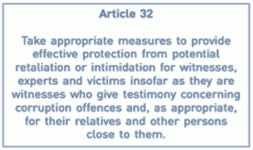
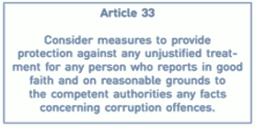
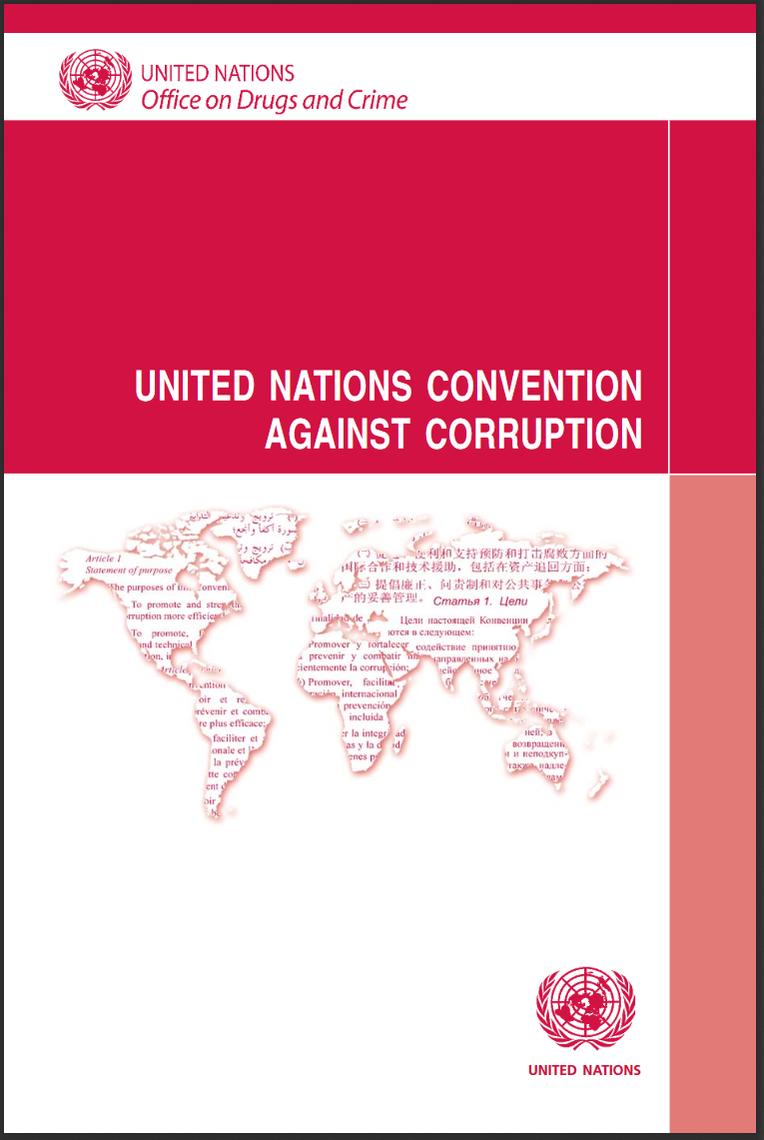
Whistleblowing in UNCAC
UNODC 2015
Notes:
Sources:
United Nations Convention against Corruption. Adopted by the UN General Assembly on 31 October 2003, by resolution 58/4. Retrieved from https://www.unodc.org/documents/treaties/UNCAC/Publications/Convention/08-50026_E.pdf (last accessed on April 7, 2020).
UNODC (August 2015). Resource Guide on Good Practices in the Protection of Reporting Persons. Retrieved from https://www.unodc.org/documents/corruption/Publications/2015/15-04741_Person_Guide_eBook.pdf (last accessed on April 7, 2020).

Slide 12
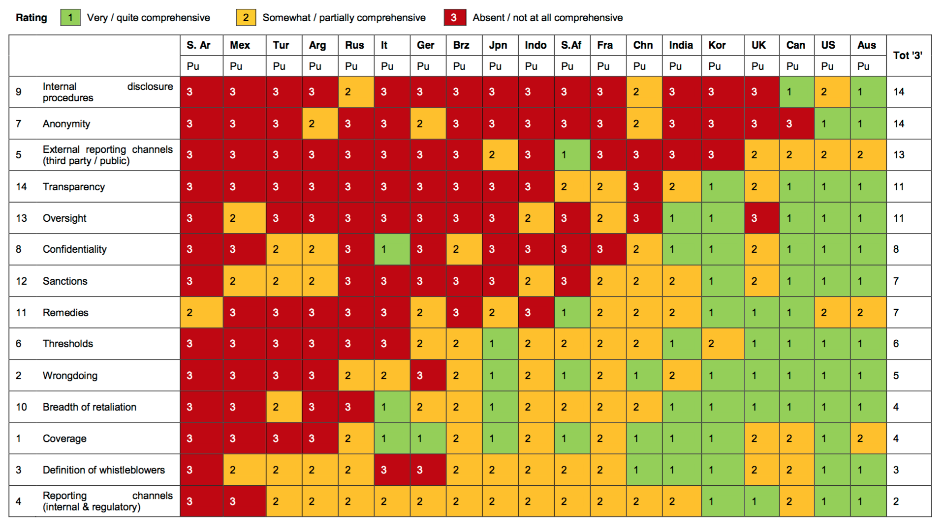
Whistleblower protection rules in G20 countries
Wolfe et al. 2014: 7
Notes:
Whislteblower protection in G20 countries:
​
Examples of best practices:
In 1998, the United Kingdom (UK) passed one of the most comprehensive whistleblower protection laws in the world: the Public Interest Disclosure Act (PIDA). The law applies to the vast majority of workers across all sectors: government, private and non-profit. It covers a range of employment categories, including employees, contractors, trainees and UK workers based abroad. Several countries have used PIDA as a template for their own laws and proposals, including Ireland, Japan and South Africa​.
The United States of America have a long history of whistleblower protection legislation. Also, as the chart above indicates, the law provides a comprehensive protection for whistleblowers and includes many of the aspects which by now are considered a good standard. However, it should be noted that a plethora of legislations regulates whistleblowing in the US public sector​.
​ ​
Source:
Wolfe, S., Worth, M., Dreyfus, S. & Brown, A. J. (June 2014). Whistleblower Protection Rules in G20 Countries: The Next Action Plan. Public Consultation Draft. Retrieved from https://news.griffith.edu.au/wp-content/uploads/2014/06/Whistleblower-Protection-Rules-in-G20-Countries-Action-Plan-June-2014.pdf (last accessed on April 24, 2020).

Slide 13
Related but different concepts
Public interest disclosure
Victimisation / protected act
Whistleblower vs. witness protection
This encourages the disclosure of information about suspected wrongdoing in the public sector. It also ensures that people who report improper conduct and corruption in the public sector can do so in the knowledge that they will be protected (Queensland Ombudsman (Australia) 2020).
Treating someone badly because they have done a ‘protected act’ (or because you believe that a person has done or is going to do a protected act). A ‘protected act’ is:
Making a claim or complaint of discrimination (under the Equality Act);
Helping someone else to make a claim by giving evidence or information;
Making an allegation that you or someone else has breached the Act;
Doing anything else in connection with the Act (Equality and Human Rights Commission (England, Wales, Scotland) 2019).
Whistleblower is any person who in good faith and voluntarily reports a suspected integrity violation. Witness is any person who is not subject of investigation but who is requested to provide information regarding a matter under investigation (Asian Development Bank 2017).
Notes:
Sources:
Asian Development Bank (2017). Whistleblower and Witness Protection. Administrative Order No. 2.10. Retrieved from https://www.adb.org/sites/default/files/page/149087/ao2-10.pdf (last accessed on April 15, 2021).
Equality and Human Rights Commission (England, Wales, Scotland) (2019). What is victimisation? Advice and Guidance. Retrieved from https://www.equalityhumanrights.com/en/advice-and-guidance/what-victimisation (last accessed on April 15, 2021).
Queensland Ombudsman (Australia) (2020). What is a public interest disclosure? Retrieved from https://www.ombudsman.qld.gov.au/improve-public-administration/public-interest-disclosures/what-is-a-public-interest-disclosure (last accessed on April 15, 2021).

Slide 14
Module agenda
01
What is whistleblowing and why is it important?
02
How to protect whistleblowers and to promote the mechanism
03
Types of reporting
04
Practical examples
05
Activity: Quiz
UN Photo/Stuart Price

Slide 15
Whistleblower protection system features
Scope
Competing rules
Incentives
Review
Complementary measures

Slide 16
Scope
Broad definition of whistleblower;
Adequate protection forms against retaliation, civil and criminal liability;
Maintaining anonymity and confidentiality of whistleblowers;
Ensuring adequate resources for reporting and protection (e.g. authority responsible for handling complaints);
Protection through sectoral laws (e.g. anti-corruption, labor, environmental protection, capital markets, company laws, …) or through a dedicated whistleblower protection / public interest disclosure law (Transparency International 2018: 18-30; Ambler n. y.).
To ensure clarity whistleblower laws should address the following issues (Khosabi 2017: 6):
Who can make a protected disclosure?​
What types of complaints should be raised?​
How should a complaint be raised?​
Who should a complaint be raised with?
Notes:
Scope:
Who can make a protected disclosure?​
What kind of complaints? Organizations should identify the types of complaints which can be raised under this specific channel, ideally with examples. Here, organizations should take care to distinguish between whistleblowing complaints (which affect customers, members of the public, or their employer) and personal grievances (regarding personal poor treatment),which can be subject to a separate complaints procedure.​
How should a complaint be raised? A policy should specify how to submit a complaint, whether it must be raised verbally, in written form, or via a dedicated hotline or web platform.
Who should a complaint be raised with? Related to the issue of how to raise a complaint, an organization should specify where or to whom a complaint should be raised, such as to a line manager, appointed ethics officer, ombudsperson or hotline, and provide contact details. The procedure for when to contact relevant external bodies, such as regulators, should also be specified and contact details provided. Alternative reporting channels to direct line management should be given.​
​
Sources:
Ambler, L. (n. y.). Whistleblower Protection Legislation and Mechanisms. OECD. Retrieved from http://www.oas.org/juridico/pdfs/enc_leah.pdf (last accessed on April 24, 2020).
Khoshabi, S. (June 2017). Internal Whistleblowing Mechnaisms. Topic Guide. Transparency Intenational. Retrieved from https://knowledgehub.transparency.org/assets/uploads/kproducts/Whistleblowing-Topic-Guide.pdf (last accessed on April 7, 2020).
Transparency International (2018). A Best Practice Guide for Whistleblowing Legislation. Retrieved from https://transparency.eu/wp-content/uploads/2018/03/2018_GuideForWhistleblowingLegislation_EN.pdf (last accessed on April 24, 2020).

Slide 17
Competing rules
Loyalty oaths
Espionage provisions
Whistleblowing
Non-disclosure agreements
Secrecy laws
Transparency International 2018: 18-30
Notes:
Competing rules:
Waiver of liability: Any disclosure made within the scope of whistleblower legislation shall be immune from disciplinary proceedings and liability under criminal, civil and administrative laws, including those related to libel, slander, copyright and data protection. The burden shall fall on the subject of the disclosure to prove any intent on the part of the whistleblower to violate the law (Transparency International Principle 10).
Preservation of rights: Any private rule or agreement is invalid if it obstructs whistleblower protections and rights. For instance, whistleblower rights shall override employee “loyalty” oaths and confidentiality/nondisclosure agreements (“gag orders”) (Transparency International Principle 12).
National security/official secrets: Where a disclosure concerns matters of national security, official or military secrets, or classified information, special procedures and safeguards for reporting that take into account the sensitive nature of the subject matter may be adopted in order to promote successful internal follow-up and resolution, and to prevent unnecessary external exposure. These procedures should permit internal disclosures, disclosure to an autonomous oversight body that is institutionally and operationally independent from the security sector, or disclosures to authorities with the appropriate security clearance. External disclosure (i.e. to the media, civil society organizations) would be justified in demonstrable cases of urgent or grave threats to public health, safety or the environment, if an internal disclosure could lead to personal harm or the destruction of evidence and if the disclosure was not intended or likely to significantly harm national security or individuals (Transparency International Principle 19).
Source:
Transparency International (2018). A Best Practice Guide for Whistleblowing Legislation. Retrieved from https://transparency.eu/wp-content/uploads/2018/03/2018_GuideForWhistleblowingLegislation_EN.pdf (last accessed on April 24, 2020).

Slide 18
Incentives
To facilitate whistleblowing, some countries have adopted incentives, incl. monetary rewards, compensation, tokens or recognition​;
Financial payments can be essential to support whistleblowers with for example living and legal expenses, following retaliation​;
Studies conclude that reward systems are effective at motivating whistleblowers to communicate information;
Bounty schemes award whistleblowers with a payment if their information leads to prosecution or recovery of funds​;
“Qui tam” measures (Maslen 2018).
Notes:
Incentives:
To facilitate whistleblowing in the public sector, some countries have adopted incentives, incl. monetary rewards, compensation, tokens or recognition​.
Financial payments can be essential to support whistleblowers with for example living and legal expenses, following retaliation​.
Studies conclude that reward systems are effective at motivating whistleblowers to communicate information.
Bounty schemes award whistleblowers with a payment if their information leads to prosecution or recovery of funds​.
“Qui tam” measures: The first whistleblower to file a case disclosing a particular fraudulent scheme to the government is eligible to receive an award equal to all or part of the damages or financial penalties recovered by the government as a result of the prosecution.
Source:
Maslen, C. (September 2018). Whistleblower Reward Programmes. Anti-corruption Helpdesk. Providing on-demand research to help fight corruption. Transparency International. Retrieved from https://knowledgehub.transparency.org/assets/uploads/helpdesk/Whistleblower-Reward-Programmes-2018.pdf (last accessed on April 7, 2020).

Slide 19
Review
Good practice recommends periodic audits or evaluation of internal reporting system for continuous improvement, which should include:​
Number, type and outcome of complaints​;
Staff awareness​;
Trust and confidence in the policy;​
Complaints of victimization or failures to maintain confidentiality (National Audit Office (United Kingdom) 2014).
Notes:
Source:
National Audit Office (United Kingdom) (March 2014). Making a whistleblowing policy work. Making a whistleblowing policy work. Report by the Comptroller and Auditor General. Retrieved from https://www.nao.org.uk/wp-content/uploads/2015/03/Making-a-whistleblowing-policy-work.pdf (last accessed on April 24, 2020).

Slide 20
Complementary measures
Sanctions treating retaliation as a disciplinary matter with penalties up to and including dismissal​
Regular staff training and whistleblowing as part of induction​ of new staff
Access for employees to independent and confidential advice
Communicate proactively on internal reporting procedures​
Shift burden of proof on the employer
Khosabi 2017: 6-7
Notes:
Complementary measures:
Communicate proactively on internal reporting procedures​, incl. promotion via intranet​, leaflets or posters​. Where possible to do so without breaching confidentiality and privacy requirements, communication to staff on instances, outcomes and lessons learned from internal reports is also recommended. It has to be communicated clearly that the organization will not tolerate any retribution against a person for raising a concern​.
Regular staff training on reporting procedures​ and whistleblowing as part of new staff induction​.
From within the organization, sanctions may include treating retaliation as a disciplinary matter, with penalties up to and including dismissal​.
Provide employees with access to independent and confidential advice regarding raising a concern​.
Shift burden of proof on the employer: In order to avoid sanctions or penalties, an employer must clearly and convincingly demonstrate that any measures taken against an employee were in no sense connected with, or motivated by, a whistleblower’s disclosure.
Source:
Khoshabi, S. (June 2017). Internal Whistleblowing Mechnaisms. Topic Guide. Transparency Intenational. Retrieved from https://knowledgehub.transparency.org/assets/uploads/kproducts/Whistleblowing-Topic-Guide.pdf (last accessed on April 7, 2020).

Slide 21
Module agenda
01
What is whistleblowing and why is it important?
02
How to protect whistleblowers and to promote the mechanism
03
Types of reporting
04
Practical examples
05
Activity: Quiz
UN Photo/Stuart Price

Slide 22
Reporting channels
Reporting within the workplace
Reporting to competent authorities
Reporting to external parties or public
European Commission 2018; OECD 2016
Notes:
Reporting channels:
Upon identifying wrongdoing, employees in the public or private sector may be uncertain of what to do with the information, where or to whom to turn, or whether they are protected by whistleblower protection mechanisms. The many steps along the disclosure process can be daunting and vague. Therefore, accessible and reliable channels for reporting wrongdoing ​should be established.
Procedures should require that all reports are acknowledged, recorded and investigated without undue delay by a specialized person or committee responsible for receiving and processing reports​. Support should be provided to reporters who make complaints in good faith, even if these turn out not to be true.
A safeguard against unfair treatment of a complaint is to provide the whistleblower with unrestricted ability to elevate the matter to higher levels within the reporting chain.
These protection mechanisms must include clear reporting channels, within and outside of the organization, ensuring confidentiality.
Also, a three-tier reporting system should be foreseen consisting of internal reporting channels, reporting to competent authorities (if internal channels do not work or could not reasonably be expected to work) and reporting to external parties or public (if no appropriate action is taken after reporting through other channels, or in case of imminent or clear danger to the public interest or irreversible damage).
Where possible and bearing in mind, for example, the need to balance the interests of the party against whom the allegations are raised, the whistleblower should be kept updated on the progress of the investigation. This provides reassurance that the complaint is being addressed and not ignored.
Sources:
European Commission (April 2018). Whistleblower protection. Retrieved from https://ec.europa.eu/commission/news/whistleblower-protection-2018-apr-23_en (last accessed on April 24, 2020).
OECD (2016). Committing to Effective Whistleblower Protection. Highlights. Retrieved from https://www.oecd.org/corruption/anti-bribery/Committing-to-Effective-Whistleblower-Protection-Highlights.pdf (last accessed on April 24, 2020).

Slide 23
Confidential, anonymous or open reporting? (1)
1. Confidential reporting
02
03
02
03
1. Open reporting
Ideal form of reporting: Concerns raised openly can be easier and quicker for the organization to understand and address, whilst risks of an environment of mistrust are minimized.
Reporters give their name on the condition that it is not revealed without their explicit consent.
Confidentiality is seen as a cornerstone for any internal complaints mechanism, protecting reporters from potential retaliation.
Khoshabi 2017: 9
Notes:
Source:
Khoshabi, S. (June 2017). Internal Whistleblowing Mechnaisms. Topic Guide. Transparency Intenational. Retrieved from https://knowledgehub.transparency.org/assets/uploads/kproducts/Whistleblowing-Topic-Guide.pdf (last accessed on April 7, 2020).

Slide 24
Confidential, anonymous or open reporting? (2)
1. Confidential reporting
02
03
02
03
03
1. Open reporting
2. Confidential reporting
Ideal form of reporting: Concerns raised openly can be easier and quicker for the organization to understand and address, whilst risks of an environment of mistrust are minimized.
Reporters give their name on the condition that it is not revealed without their explicit consent.
Confidentiality is seen as a cornerstone for any internal complaints mechanism, protecting reporters from potential retaliation.
Reporters give their name on the condition that it is not revealed without their explicit consent.
Confidentiality is seen as a cornerstone for any internal complaint mechanism, protecting reporters from potential retaliation.
Khoshabi 2017: 9
Notes:
Source:
Khoshabi, S. (June 2017). Internal Whistleblowing Mechnaisms. Topic Guide. Transparency Intenational. Retrieved from https://knowledgehub.transparency.org/assets/uploads/kproducts/Whistleblowing-Topic-Guide.pdf (last accessed on April 7, 2020).

Slide 25
Confidential, anonymous or open reporting? (3)
1. Confidential reporting
02
03
02
03
03
1. Open reporting
3. Anonymuous reporting
2. Confidential reporting
Ideal form of reporting: Concerns raised openly can be easier and quicker for the organization to understand and address, whilst risks of an environment of mistrust are minimized.
Reporters give their name on the condition that it is not revealed without their explicit consent.
Confidentiality is seen as a cornerstone for any internal complaints mechanism, protecting reporters from potential retaliation.
This is often criticized for lack of detail which would allow to trace the disclosure back to the reporter.
Organizations should outline limitations and try to ensure full protection if identity is revealed.
Reporters give their name on the condition that it is not revealed without their explicit consent.
Confidentiality is seen as a cornerstone for any internal complaints mechanism, protecting reporters from potential retaliation.
Khoshabi 2017: 9
Notes:
Source:
Khoshabi, S. (June 2017). Internal Whistleblowing Mechnaisms. Topic Guide. Transparency Intenational. Retrieved from https://knowledgehub.transparency.org/assets/uploads/kproducts/Whistleblowing-Topic-Guide.pdf (last accessed on April 7, 2020).

Slide 26
Module agenda
01
What is whistleblowing and why is it important?
02
How to protect whistleblowers and to promote the mechanism
03
Types of reporting
04
Practical examples
05
Activity: Quiz
UN Photo/Stuart Price

Slide 27
Practical examples
Austria: Anonymous reporting platform
Ghana: Whistleblower protection and speak up campaign

Slide 28
Ghana: Whistleblower protection and speak up campaign
Ghana’s 2006 whistleblower protection law provides legal protection and remedies to all who report crime and misconduct in the public interest;
Following an investigation and hearing of the whistleblower and the person against whom the complaint is made, the Commission on Human Rights and Administrative Justice​ may propose:
(a) Reinstatement;​
(b) Reversal of a transfer or the transfer of the whistle-blower to another establishment; or​
(c) An order for payment of a reward from a fund established under the Act (UNODC 2015: 63).
Act was accompanied by an interactive awareness-raising campaign (UNODC 2015: 79);
Challenge: Ghanaians were reported to be unwilling to acquire the whistleblowing habit due to concerns over identity protection (Suuk 2016).
Notes:
Ghana: Whistleblower protection and speak up campaign:
Ghana has a whistleblower protection law (2006) that is considered among the strongest in Africa. It provides legal protections and remedies to everyone who reports crime and misconduct in the public interest.
Anyone who honestly and reasonably believes that they have been subjected to victimization or learns that they are likely to be victimized because they have made a disclosure, may in the first instance make a complaint to the Commission on Human Rights and Administrative Justice​.
Following an investigation and hearing, the Commission may propose: ​
(a) reinstatement;​
(b) reversal of a transfer or the transfer of the whistle-blower to another establishment; or​
(c) an order for payment of a reward from a fund established under the Act for that purpose.
The Act was accompanied by an awareness-raising campaign educating Ghanaians on the 2006 Whistleblowers Act ​designed in collaboration with the national media partners​.
The campaign was designed as an interactive project where the public can submit comments and questions on the Whistleblower Act and corruption in general, by calling, sending text messages to a dedicated short-code and engaging on the campaign’s official Facebook page.
Sources:
Suuk, M. (2015). Why are Ghanaians reluctant whistleblowers? Deutsche Welle. Retrieved from https://www.dw.com/en/why-are-ghanaians-reluctant-whistleblowers/a-19441793 (last accessed on April 24, 2020).
The Seven Hundred and Twentieth Act of the Parliament of the Republic of Ghana entitled the Whistleblower Act, 2006. Retrieved from http://www.drasuszodis.lt/userfiles/Ghana%20Whitsleblwer%20Act.pdf (last accessed on April 24, 2020).
UNODC (August 2015). Resource Guide on Good Practices in the Protection of Reporting Persons. Retrieved from https://www.unodc.org/documents/corruption/Publications/2015/15-04741_Person_Guide_eBook.pdf (last accessed on April 7, 2020).

Slide 29
Austria: Anonymous reporting platform
Dedicated online reporting web-platform for corruption and related criminal offences;
Managed by specialists, specifically the Public Prosecutor’s Office for White-Collar Crime and Corruption (WKStA)​;
System assures anonymity, as the authorities cannot trace any identifying data, but equally allows for two-way communication​;
Within the first year of operation, 1,200 reports were submitted​;
Reports were either investigated by the WKStA or transferred to the appropriate institution (UNODC 2015: 51; Zentrale Staatsanwaltschaft zur Verfolgung von Wirtschaftsstrafsachen und Korruption 2016: 5).
Notes:
Sources:
UNODC (August 2015). Resource Guide on Good Practices in the Protection of Reporting Persons. Retrieved from https://www.unodc.org/documents/corruption/Publications/2015/15-04741_Person_Guide_eBook.pdf (last accessed on April 7, 2020).
Zentrale Staatsanwaltschaft zur Verfolgung von Wirtschaftsstrafsachen und Korruption (2016). Mediengespräch 2016. Das BKMS®-Hinweisgebersystem. Retrieved from https://www.justiz.gv.at/file/2c9484853d643b33013d8860aa5a2e59.de.0/informationsbrosch%C3%BCre%20zum%20hinweisgebersystem.pdf?forcedownload=true (last accessed on August 26, 2020).

Slide 30
Module agenda
01
What is whistleblowing and why is it important?
02
How to protect whistleblowers and to promote the mechanism
03
Types of reporting
04
Practical examples
05
Activity: Quiz
UN Photo/Stuart Price

Slide 31
Activity
UN Photo/Mark Garten

Slide 32
Quiz (1)
1. Which of the following should be considered when deciding whether or not to blow the whistle (several mentions are possible)?
A. Is the situation of sufficient moral importance to justify whistleblowing?
B. Do you have all facts and have you properly understood their significance?
C. Have all internal channels and steps short of whistleblowing been exhausted?
2. Which of the following are components of a well-designed whistleblowing policy (several mentions possible)?
A. An effectively communicated statement of responsibility.
B. A clearly defined procedure for reporting.
C. Trained personnel to receive and investigate reports.
D. A commitment to take appropriate follow-action.
Notes:
Correct answers:
= A., B. and C.
= A., B., C. and D.

Slide 33
Quiz (2)
3. What could be wrongdoings in a workplace subject to whistleblowing (several mentions possible)?
A. Corruption
B. Unsafe workplace
C. Violated laws
Notes:
Correct answers:
3. = A., B. and C.

Slide 34
Learning outcomes
In this module you have learned that:
Whistleblowing is an important mechanism supporting anti-corruption and enhancing integrity in the public sector;
Effective whistleblower protection requires strong legal frameworks, raising confidence that those reporting wrongdoing are adequately protected​;
At the same time, effective whistleblowing mechanisms also rely on awareness-raising and training in order to change mindsets regarding attitudes on reporting.
...

Slide 35
References (1)
African Union (2003). African Union Convention on Preventing and Combating Corruption. Retrieved from https://au.int/sites/default/files/treaties/36382-treaty-0028_-_african_union_convention_on_preventing_and_combating_corruption_e.pdf (last accessed on April 23, 2020).
Ambler, L. (n. y.). Whistleblower Protection Legislation and Mechanisms. OECD. Retrieved from http://www.oas.org/juridico/pdfs/enc_leah.pdf (last accessed on April 24, 2020).
Asian Development Bank (2017). Whistleblower and Witness Protection. Administrative Order No. 2.10. Retrieved from https://www.adb.org/sites/default/files/page/149087/ao2-10.pdf (last accessed on April 15, 2021).
Cronin, E. A. & Afifi, A. (2018). Review of whistle-blower plicies and practices in United Nations system organizations. United Nations Joint Inspection Unit. Retrieved from https://www.unjiu.org/sites/www.unjiu.org/files/jiu_rep_2018_4_english_0.pdf (last accessed on August 26, 2020).
Equality and Human Rights Commission (England, Wales, Scotland) (2019). What is victimisation? Advice and Guidance. Retrieved from https://www.equalityhumanrights.com/en/advice-and-guidance/what-victimisation (last accessed on April 15, 2021).
European Commission (April 2018). Whistleblower protection. Retrieved from https://ec.europa.eu/commission/news/whistleblower-protection-2018-apr-23_en (last accessed on April 24, 2020).
Khoshabi, S. (June 2017). Internal Whistleblowing Mechnaisms. Topic Guide. Transparency Intenational. Retrieved from https://knowledgehub.transparency.org/assets/uploads/kproducts/Whistleblowing-Topic-Guide.pdf (last accessed on April 7, 2020).
Maslen, C. (September 2018). Whistleblower Reward Programmes. Anti-corruption Helpdesk. Providing on-demand research to help fight corruption. Transparency International. Retrieved from https://knowledgehub.transparency.org/assets/uploads/helpdesk/Whistleblower-Reward-Programmes-2018.pdf (last accessed on April 7, 2020).
National Audit Office (United Kingdom) (March 2014). Making a whistleblowing policy work. Making a whistleblowing policy work. Report by the Comptroller and Auditor General. Retrieved from https://www.nao.org.uk/wp-content/uploads/2015/03/Making-a-whistleblowing-policy-work.pdf (last accessed on April 24, 2020).
OECD (2016). Committing to Effective Whistleblower Protection. Highlights. Retrieved from https://www.oecd.org/corruption/anti-bribery/Committing-to-Effective-Whistleblower-Protection-Highlights.pdf (last accessed on April 24, 2020).
OECD (July 2012). Whistleblower protection: encouraging reporting. CleanGovBiz. Retrieved from https://old.nazk.gov.ua/sites/default/files/docs/nazk_files/%D0%B0%D0%BD%D1%82%D0%B8%D0%BA%D0%BE%D1%80%D0%B4%D0%BE%D1%81%D0%BB%D1%96%D0%B4%D0%B6%D0%B5%D0%BD%D0%BD%D1%8F/21.pdf (last accessed on April 24, 2020).
OECD (May 2011). Study on Whistleblower Protection Frameworks: Compendium of Best Practices and Guiding Principles for Legislation. G20 Anti-Corruption Action Plan. Retrieved from https://www.oecd.org/g20/topics/anti-corruption/48972967.pdf (last accessed on April 24, 2020).
Organization of American States (1996). Inter-American Convention Against Corruption (B-58). Retrieved from http://www.oas.org/en/sla/dil/docs/inter_american_treaties_B-58_against_Corruption.pdf (last accessed on April 23, 2020).
Queensland Ombudsman (Australia) (2020). What is a public interest disclosure? Retrieved from https://www.ombudsman.qld.gov.au/improve-public-administration/public-interest-disclosures/what-is-a-public-interest-disclosure (last accessed on April 15, 2021).
Scaturro, R. (May 2018). Defining Whistleblowing. IACA Research Paper Series No. 5. International Anti-corruption Academy. Retrieved from https://www.iaca.int/wwwtest/media/attachments/2018/06/18/research_paper_05_ruggero_scaturro_final.pdf (last accessed on April 24, 2020).

Slide 36
References (2)
Suuk, M. (2015). Why are Ghanaians reluctant whistleblowers? Deutsche Welle. Retrieved from https://www.dw.com/en/why-are-ghanaians-reluctant-whistleblowers/a-19441793 (last accessed on April 24, 2020).
The Seven Hundred and Twentieth Act of the Parliament of the Republic of Ghana entitled the Whistleblower Act, 2006. Retrieved from http://www.drasuszodis.lt/userfiles/Ghana%20Whitsleblwer%20Act.pdf (last accessed on April 24, 2020).
Transparency International (2018). A Best Practice Guide for Whistleblowing Legislation. Retrieved from https://transparency.eu/wp-content/uploads/2018/03/2018_GuideForWhistleblowingLegislation_EN.pdf (last accessed on April 24, 2020).
Transparency International (November 2013). International principles for whistleblower legislation. Best Practices for Laws to Protect Whistleblowers and Support Whistleblowing in the Public Interest. Retrieved from http://files.transparency.org/content/download/696/2991/file/2013_WhistleblowerPrinciples_EN.pdf (last accessed on April 7, 2020).
United Nations Convention against Corruption. Adopted by the UN General Assembly on 31 October 2003, by resolution 58/4. Retrieved from https://www.unodc.org/documents/treaties/UNCAC/Publications/Convention/08-50026_E.pdf (last accessed on April 7, 2020).
UNODC (August 2015). Resource Guide on Good Practices in the Protection of Reporting Persons. Retrieved from https://www.unodc.org/documents/corruption/Publications/2015/15-04741_Person_Guide_eBook.pdf (last accessed on April 7, 2020).
Wolfe, S., Worth, M., Dreyfus, S. & Brown, A. J. (June 2014). Whistleblower Protection Rules in G20 Countries: The Next Action Plan. Public Consultation Draft. Retrieved from https://news.griffith.edu.au/wp-content/uploads/2014/06/Whistleblower-Protection-Rules-in-G20-Countries-Action-Plan-June-2014.pdf (last accessed on April 7, 2020).
Zentrale Staatsanwaltschaft zur Verfolgung von Wirtschaftsstrafsachen und Korruption (2016). Mediengespräch 2016. Das BKMS®-Hinweisgebersystem. Retrieved from https://www.justiz.gv.at/file/2c9484853d643b33013d8860aa5a2e59.de.0/informationsbrosch%C3%BCre%20zum%20hinweisgebersystem.pdf?forcedownload=true (last accessed on August 26, 2020).

Slide 37
Thank you.

