Slide 1
Module 1 – How would a world without corruption look?
Toolkit on Transparency, Accountability and Ethics in Public Institutions

Slide 2
Training agenda
Time | Day 1: Fundamentals of ethics and public integrity | Day 2: Ethics and public integrity at the institutional and policy level | Day 3: Organizational change for enhanced ethics and integrity | Day 4: Individual ethical behavior | Day 5: Developing a strategy, roadmap and action plan for enhanced ethics and public integrity
Morning | Module 1 - How would a world without corruption look? | Module 6 - Oversight institutions | Module 11 - Staff management and developing capacities for integrity | Module 14 - Ethical leadership | Module 18 - Preparation phase
 | Module 2 - Essentials of ethics and public integrity | Module 7 - Social accountability mechanisms | Module 12 - Creating an organizational culture of ethics and integrity | Module 15 - Assessing personal vis-à-vis organizational values
Lunch break
Afternoon | Module 3 - Transparency and accountability | Module 8 - Integrity codes | Module 13 - Transparent public procurement | Module 16 - Behavioral insights and staff incentives | Module 18 - Presentation and feedback phase
 | Module 4 - Understanding and assessing corruption | Module 9 - Managing conflict of interest |  | Module 17 - How to promote desired behavioral change?
 | Module 5 - International frameworks for integrity and anti-corruption | Module 10 - Whistleblowing

Slide 3
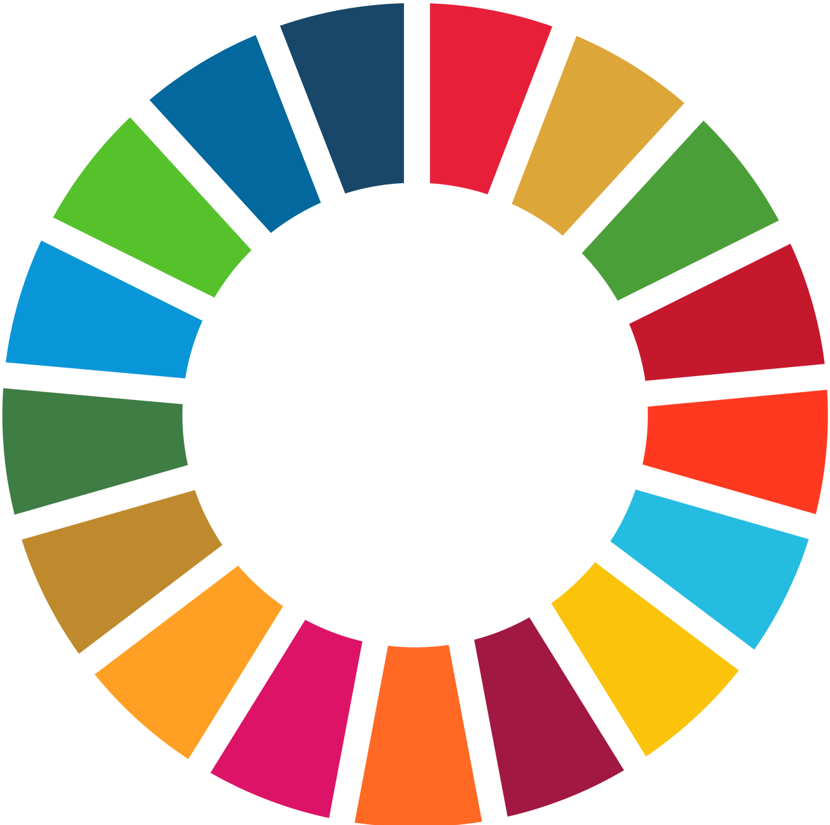
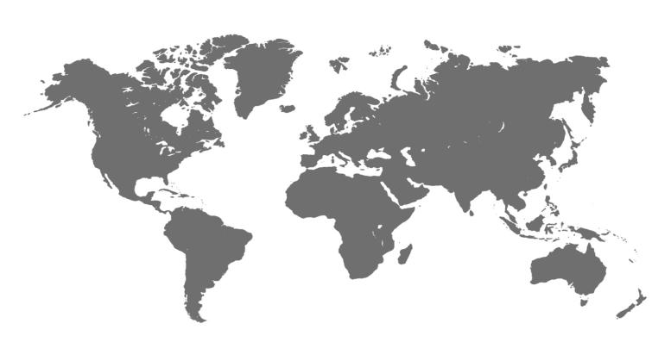
Welcome to the Toolkit on Transparency, Accountability and Ethics in Public Institutions

Slide 4
Let‘s get started with a short video ...

Slide 5
“Corruption is the ultimate betrayal of public trust.” – António Guterres, UN Secretary-General
United Nations 2020
Notes:
Let's get started with a short video …:
Play the video to break ice and approach issues. The purpose is to provide a high-level entry point to the topic of (anti-)corruption and to give input for the subsequent brainstorming activity.
Source:
United Nations (October 2020). Corruption in the Context of COVID-19 – António Guterres, UN Secretary-General. Retrieved from https://www.youtube.com/watch?v=SzgT-kqOiXw (last accessed on March 29, 2021).

Slide 6
... so, and how about a world without corruption?
How would it look?

Slide 7
Let‘s check the web for some answers ...

Slide 8
Some opinions on corruption from the web (1)
Forum posts from Quora 2018-2020
Do you like (👍 ) or dislike (👎︎ ) the forum post?
And, what would you comment?
Notes:
Some opinions on corruption from the web:
This slide presents four – partly philosophical – opinions from an online forum on corruption and more specifically on how a corruption-free world would look like.
Present the opinions one after another and ask different participants to read each out.
Ask participants if they agree (like) or don‘t agree (dislike) with the opinions given on the web and why they decide so.
The purpose of the exchange is to give examples of how people are thinking about corruption and to give further input for the subsequent brainstorming activity.
Source:
Forum posts from Quora retrieved from https://www.quora.com/What-would-the-world-look-like-without-corruption (last accessed on June 26, 2020).

Slide 9
Some opinions on corruption from the web (2)
Forum posts from Quora 2018-2020
Do you like (👍 ) or dislike (👎︎ ) the forum post?
And, what would you comment?
Notes:
Some opinions on corruption from the web:
This slide presents four – partly philosophical – opinions from an online forum on corruption and more specifically on how a corruption-free world would look like.
Present the opinions one after another and ask different participants to read each out.
Ask participants if they agree (like) or don‘t agree (dislike) with the opinions given on the web and why they decide so.
The purpose of the exchange is to give examples of how people are thinking about corruption and to give further input for the subsequent brainstorming activity.
Source:
Forum posts from Quora retrieved from https://www.quora.com/What-would-the-world-look-like-without-corruption (last accessed on June 26, 2020).

Slide 10
Some opinions on corruption from the web (3)
Forum posts from Quora 2018-2020
Do you like (👍 ) or dislike (👎︎ ) the forum post?
And, what would you comment?
Notes:
Some opinions on corruption from the web:
This slide presents four – partly philosophical – opinions from an online forum on corruption and more specifically on how a corruption-free world would look like.
Present the opinions one after another and ask different participants to read each out.
Ask participants if they agree (like) or don‘t agree (dislike) with the opinions given on the web and why they decide so.
The purpose of the exchange is to give examples of how people are thinking about corruption and to give further input for the subsequent brainstorming activity.
Source:
Forum posts from Quora retrieved from https://www.quora.com/What-would-the-world-look-like-without-corruption (last accessed on June 26, 2020).

Slide 11
Many people think government corruption will get worse in 2045 …
United Nations 2020: 63
Notes:
Many people think government corruption will get worse in 2045 ...:
In 2020, the UN launched the global consultation to mark its 75th anniversary. Through surveys and dialogues, it asked people about their hopes and fears for the future.
In one specific question, people were asked the following: “At the global level, how do you think each of the following things will be in 2045 compared to how they are today?“. Around 35,000 people responded to this question.
41% of respondents stated that government corruption will get worse by 2045 and 27% stated that it would stay the same. This means two-thirds of people (68%) do not think that government corruption will get any better.
This suggests that government corruption, along with condition of the natural environment and poverty, is a top issue to be tackled by the international community.
Source:
United Nations (2020). The Future We Want The United Nations We Need. Update on the Work of the Office on the Commemoration of the UN’s 75th Anniversary. September 2020. Retrieved from https://www.un.org/sites/un2.un.org/files/un75report_september_final_english.pdf (last accessed on October 9, 2020).

Slide 12
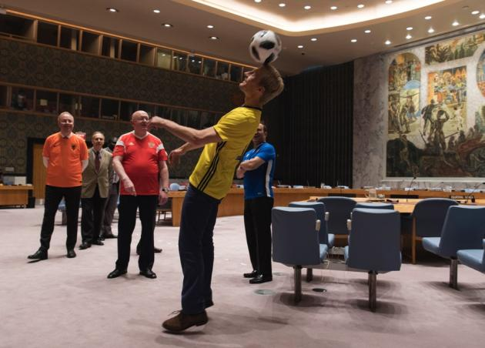
Activity
UN Photo/Mark Garten

Slide 13
Structured brainstorming on a world free from corruption (Activity 1)
Why?
- To raise awareness of the variety of perceptions that participants associate with the causes and consequences of corruption.
- This first activity also helps to set a benchmark as to the level of knowledge in the room about the topic.
- Input received though the activity may be used to tailor the rest of the training more specifically.
What?
- Form small groups of participants;
- Discuss, agree and jot down 5 messages for your mission statement on how a world free from corruption would look. Let the template on the following slide guide you. As for content, draw perhaps inspiration from the SDGs, the UN Secretary-General’s statement or toolkit video. Be creative!
- Groups present their brainstormed content to others.
Time
Reserve ca. 15 minutes for the structured brainstorming in small groups as well ca. 15 minutes for group presentations of the content that was brainstormed.
Resources
For the brainstorming, flipchart papers and markers should be made available.
Notes:
Structured brainstorming on a world free from corruption:
Why?
To raise awareness of the variety of perceptions that participants associate with the causes and consequences of corruption.
This first activity also helps to set a benchmark as to the level of knowledge in the room about the topic.
Input received though the activity may be used to tailor the rest of the training more specifically.
What?
This activity could also be called the verb game and is a structured approach to brainstorming. It aims to get participants‘ thinking about a corruption-free world through the lens of different introductory verbs triggering effects of such a corruption-free world.
Form small groups of participants;
Discuss, agree and jot down 5 messages for your mission statement on how a world free from corruption would look. Let the template on the following slide guide you. As for content, draw perhaps inspiration from the SDGs, the UN Secretary-General’s statement or toolkit video. Be creative!
In the oval, you find a long list of verbs.
As a first step, each member of a small group gets to circle a maximum of five verbs. Group members can also add verbs not listed.
Then, take the five verbs that counted the most circles (votes) to trigger another phase of ideation and discussion by taking these verbs as elements fo finish five visionary statements starting with “Our world without corruption aims to ... “.
The output should be a mission statement composed of five commonly agreed and fudamental statements of how a world without corruption should look.
The mission statement is to be presented to all the other training participants.
Time:
Reserve ca. 15 minutes for the structured brainstorming in small groups as well ca. 15 minutes for group presentations of the content that was brainstormed.
Resources:
For the brainstorming, flipchart papers and markers should be made available.

Slide 14
Mission statement template
Pick 5 verbs to introduce short paragraphs on how your envisioned world without corruption should look like.
Our world without corruption aims to:
1. Inspire ... __________________________
2. __________________________3. __________________________
4. __________________________5. __________________________
Inspire / Inform / Advise / Warn / Scare / Comfort / Influence / Teach / Encourage / Protect / Serve / Help / Alert / Wow / Reassure / Provoke / Train / Persuade / Educate / Excite / Organize / Surprise / Intrigue / Transform / Coach etc.

Slide 15
Ethics self-assessment (Activity 2)
Why?
The ethics self-assessment helps participants identify (i) areas in which they are on strong ethical ground, (ii) areas that they may wish to examine, including the basis for their responses and (iii) opportunities for further reflection. Based on the results from the ethics self-assessment and overall learnings from the training, participants will set up and present their development plans for enhanced ethics and public integrity in Module 18 on Day 5.
What?
- Ethics self-assessment with 50 statements about ethical and professional conduct across six different categories;
- Check only one answer for each of the statements;
- Review the responses and make note of statements answered with “usually,” “occasionally”, and, “almost never”. Reflect and decide on the ones to address;
- On Day 5, using the development plan template provided, identify appropriate actions to improve ethical behaviors.
Time
The ethics self-assessment questionnaire should be completed within 15 minutes on Day 1.
Resources
The (printed) ethics self-assessment questionnaire can be provided to participants by the trainer, so that they can keep their input for later.
Project Management Institute (PMI) 2018
Notes:
Ethics self-assessment (Activity 2):
Why?
The ethics self-assessment tool is intended for personal use and assist the user in thinking about his or her own ethics-related leadership and actions.
A user can choose to begin assessing her or his ethical behaviors at any time. The initial assessment will help any practitioner understand the current state of their personal ethics, which then provides the information necessary to build a stronger personal ethics for the future. Ongoing assessments and re-evaluations will help the user to commit to sustaining ongoing and continuous ethics improvement. The tool is an excellent way to measure the overall health of one’s individual ethics and plan for improvements.
The ethics self-assessment helps participants identify (i) areas in which they are on strong ethical ground, (ii) areas that they may wish to examine, including the basis for their responses and (iii) opportunities for further reflection.
Based on the results from the ethics self-assessment and overall learnings from the training, participants will set up and present their development plans for enhanced ethics and public integrity in Module 18 on Day 5. The annexed template for a personal ethics development plan should not yet be filled in this module.
What?
The ethics self-assessment questionnaire consists of 50 statements about ethical and professional conduct across six different categories.
This tool does not have a scoring mechanism, as we do not believe that ethical behavior can or should be quantified.
Step 1: Check only one answer for each of the statements. Only statements applicable to your role and responsibilities in your workplace/lifeneed to be responded to. Neither is the list exhaustive; if you have other personal considerations not explicitly called forward in the assessment tool, make note of them for reflection and inclusion in your development plan, as appropriate
Step 2: Once all the statements have been answered, take time, review the responses, and make note of statements answered with “usually,” “occasionally”, and, “almost never”. Identify which of the answers may raise concerns (“red flags”); reflect and decide on the ones to address.
Step 3: On Day 5 of the training, using the development plan provided, identify appropriate next actions for yourself to develop and refine your ethical behaviors. In doing so, follow three recommendations: (1) Establish realistic targets to continue to be motivated; (2) Choose one to three activities to work on at a time to establish priorites; (3) Review the plan periodically and monitor your progress.
Time:
The ethics self-assessment questionnaire should be completed within 15 minutes on Day 1.
Resources:
The (printed) ethics self-assessment questionnaire can be provided to participants by the trainer, so that they can keep their input for later.
Source:
Project Management Institute (PMI) (August 2018). Ethics Toolkit. Ethics Self Assessment. Retrieved from https://www.pmi.org/-/media/pmi/documents/public/pdf/ethics/ethics-self-assessment.pdf?v=b8c50e98-936f-4b14-9f53-ae1d50fe4afc (last accessed on August 31, 2020).

Slide 16
Ethics self-assessment questionnaire
50 statements about ethical and professional conduct across six categories;
Only statements applicable to your role and responsibilities need to be responded to;
No scoring mechanism.
Leadership
Board
Community
Suppliers
Clients
Colleagues and staff
Project Management Institute (PMI) 2018
Notes:
Source:
Project Management Institute (PMI) (August 2018). Ethics Toolkit. Ethics Self Assessment. Retrieved from https://www.pmi.org/-/media/pmi/documents/public/pdf/ethics/ethics-self-assessment.pdf?v=b8c50e98-936f-4b14-9f53-ae1d50fe4afc (last accessed on August 31, 2020).

Slide 17
Ethics self-assessment - Leadership (1)
01. I take courageous, consistent and appropriate management actions to overcome barriers to achieving my organization’s mission.
Almost Never ❒ | Occasionally ❒ | Usually ❒ | Always ❒ | N/A ❒
02. I place community benefit over my personal gain.
Almost Never ❒ | Occasionally ❒ | Usually ❒ | Always ❒ | N/A ❒
03. I strive to be a role model for ethical behavior.
Almost Never ❒ | Occasionally ❒ | Usually ❒ | Always ❒ | N/A ❒
04. My statements and actions are consistent with professional ethical standards laid down in applicable codes of ethics and conduct.
Almost Never ❒ | Occasionally ❒ | Usually ❒ | Always ❒ | N/A ❒
05. My statements and actions are honest even when circumstances would allow me to confuse the issues.
Almost Never ❒ | Occasionally ❒ | Usually ❒ | Always ❒ | N/A ❒
Project Management Institute (PMI) 2018
Project Management Institute (PMI) 2018
Notes:
Source:
Project Management Institute (PMI) (August 2018). Ethics Toolkit. Ethics Self Assessment. Retrieved from https://www.pmi.org/-/media/pmi/documents/public/pdf/ethics/ethics-self-assessment.pdf?v=b8c50e98-936f-4b14-9f53-ae1d50fe4afc (last accessed on August 31, 2020).

Slide 18
Ethics self-assessment - Leadership (2)
06. I advocate ethical decision making by the board, management team and other staff.
Almost Never ❒ | Occasionally ❒ | Usually ❒ | Always ❒ | N/A ❒
07. I use an ethical approach to conflict resolution.
Almost Never ❒ | Occasionally ❒ | Usually ❒ | Always ❒ | N/A ❒
08. I initiate and encourage discussion of the ethical aspects of management and financial issues.
Almost Never ❒ | Occasionally ❒ | Usually ❒ | Always ❒ | N/A ❒
09. I promptly and candidly explain to internal and external stakeholders negative economic trends and encourage appropriate action.
Almost Never ❒ | Occasionally ❒ | Usually ❒ | Always ❒ | N/A ❒
10. I use my authority solely to fulfill my responsibilities and not for self-interest or to further the interests of family, friends or associates.
Almost Never ❒ | Occasionally ❒ | Usually ❒ | Always ❒ | N/A ❒
Project Management Institute (PMI) 2018
Notes:
Source:
Project Management Institute (PMI) (August 2018). Ethics Toolkit. Ethics Self Assessment. Retrieved from https://www.pmi.org/-/media/pmi/documents/public/pdf/ethics/ethics-self-assessment.pdf?v=b8c50e98-936f-4b14-9f53-ae1d50fe4afc (last accessed on August 31, 2020).

Slide 19
Ethics self-assessment - Leadership (3)
11. When an ethical conflict confronts my organization or me, I am successful in finding an effective resolution process and ensure it is followed.
Almost Never ❒ | Occasionally ❒ | Usually ❒ | Always ❒ | N/A ❒
12. I demonstrate respect for my colleagues, superiors and staff.
Almost Never ❒ | Occasionally ❒ | Usually ❒ | Always ❒ | N/A ❒
13. I demonstrate my organization’s vision, mission and value statements in my actions.
Almost Never ❒ | Occasionally ❒ | Usually ❒ | Always ❒ | N/A ❒
14. I make timely decisions rather than delaying them to avoid difficult or politically risky choices.
Almost Never ❒ | Occasionally ❒ | Usually ❒ | Always ❒ | N/A ❒
15. I seek the advice of an internal ethics committee when making ethically challenging decisions.
Almost Never ❒ | Occasionally ❒ | Usually ❒ | Always ❒ | N/A ❒
Project Management Institute (PMI) 2018
Notes:
Source:
Project Management Institute (PMI) (August 2018). Ethics Toolkit. Ethics Self Assessment. Retrieved from https://www.pmi.org/-/media/pmi/documents/public/pdf/ethics/ethics-self-assessment.pdf?v=b8c50e98-936f-4b14-9f53-ae1d50fe4afc (last accessed on August 31, 2020).

Slide 20
Ethics self-assessment - Leadership (4)
16. My personal expense reports are accurate and are only billed to the appropriate organization(s).
Almost Never ❒ | Occasionally ❒ | Usually ❒ | Always ❒ | N/A ❒
17. I openly support establishing and monitoring internal mechanisms (e.g., an ethics committee or program) to support ethical decision making.
Almost Never ❒ | Occasionally ❒ | Usually ❒ | Always ❒ | N/A ❒
18. I thoughtfully consider decisions when making a promise on behalf of the organization to a person or a group of people.
Almost Never ❒ | Occasionally ❒ | Usually ❒ | Always ❒ | N/A ❒
Project Management Institute (PMI) 2018
Notes:
Source:
Project Management Institute (PMI) (August 2018). Ethics Toolkit. Ethics Self Assessment. Retrieved from https://www.pmi.org/-/media/pmi/documents/public/pdf/ethics/ethics-self-assessment.pdf?v=b8c50e98-936f-4b14-9f53-ae1d50fe4afc (last accessed on August 31, 2020).

Slide 21
Ethics self-assessment - Community
19. I promote community member relations improvement as a guiding goal of my organization and as a cornerstone of my efforts on behalf of my organization.
Almost Never ❒ | Occasionally ❒ | Usually ❒ | Always ❒ | N/A ❒
20. I personally devote time to developing solutions to community problems.
Almost Never ❒ | Occasionally ❒ | Usually ❒ | Always ❒ | N/A ❒
21. I participate in and encourage my management team to devote personal time to community service.
Almost Never ❒ | Occasionally ❒ | Usually ❒ | Always ❒ | N/A ❒
Project Management Institute (PMI) 2018
Notes:
Source:
Project Management Institute (PMI) (August 2018). Ethics Toolkit. Ethics Self Assessment. Retrieved from https://www.pmi.org/-/media/pmi/documents/public/pdf/ethics/ethics-self-assessment.pdf?v=b8c50e98-936f-4b14-9f53-ae1d50fe4afc (last accessed on August 31, 2020).

Slide 22
Ethics self-assessment - Clients
22. I use a client-oriented approach to project management.
Almost Never ❒ | Occasionally ❒ | Usually ❒ | Always ❒ | N/A ❒
23. I respect the practices and customs of the diverse clients while maintaining the organization’s mission.
Almost Never ❒ | Occasionally ❒ | Usually ❒ | Always ❒ | N/A ❒
24. I promote document confidentiality and do not tolerate breaches of this confidentiality.
Almost Never ❒ | Occasionally ❒ | Usually ❒ | Always ❒ | N/A ❒
Project Management Institute (PMI) 2018
Notes:
Source:
Project Management Institute (PMI) (August 2018). Ethics Toolkit. Ethics Self Assessment. Retrieved from https://www.pmi.org/-/media/pmi/documents/public/pdf/ethics/ethics-self-assessment.pdf?v=b8c50e98-936f-4b14-9f53-ae1d50fe4afc (last accessed on August 31, 2020).

Slide 23
Ethics self-assessment - Colleagues and staff (1)
25. I foster discussions about ethical concerns when they arise.
Almost Never ❒ | Occasionally ❒ | Usually ❒ | Always ❒ | N/A ❒
26. I maintain confidences entrusted to me.
Almost Never ❒ | Occasionally ❒ | Usually ❒ | Always ❒ | N/A ❒
27. I demonstrate through personal actions and organizational policies, a zero tolerance for any form of harassment.
Almost Never ❒ | Occasionally ❒ | Usually ❒ | Always ❒ | N/A ❒
28. I encourage discussions about and advocate for the implementation of the organization’s code of ethics and value statements.
Almost Never ❒ | Occasionally ❒ | Usually ❒ | Always ❒ | N/A ❒
29. I fulfill the promises I make.
Almost Never ❒ | Occasionally ❒ | Usually ❒ | Always ❒ | N/A ❒
Project Management Institute (PMI) 2018
Notes:
Source:
Project Management Institute (PMI) (August 2018). Ethics Toolkit. Ethics Self Assessment. Retrieved from https://www.pmi.org/-/media/pmi/documents/public/pdf/ethics/ethics-self-assessment.pdf?v=b8c50e98-936f-4b14-9f53-ae1d50fe4afc (last accessed on August 31, 2020).

Slide 24
Ethics self-assessment - Colleagues and staff (2)
30. I am respectful of views different from mine.
Almost Never ❒ | Occasionally ❒ | Usually ❒ | Always ❒ | N/A ❒
31. I am respectful of individuals who differ from me in ethnicity, gender, education or job position.
Almost Never ❒ | Occasionally ❒ | Usually ❒ | Always ❒ | N/A ❒
32. I convey negative news promptly and openly, not allowing employees or others to be misled.
Almost Never ❒ | Occasionally ❒ | Usually ❒ | Always ❒ | N/A ❒
33. I expect and hold staff accountable for adherence to our organization’s ethical standards (e.g., performance reviews).
Almost Never ❒ | Occasionally ❒ | Usually ❒ | Always ❒ | N/A ❒
34. I demonstrate that incompetent supervision is not tolerated and make timely decisions regarding marginally performing managers.
Almost Never ❒ | Occasionally ❒ | Usually ❒ | Always ❒ | N/A ❒
Project Management Institute (PMI) 2018
Notes:
Source:
Project Management Institute (PMI) (August 2018). Ethics Toolkit. Ethics Self Assessment. Retrieved from https://www.pmi.org/-/media/pmi/documents/public/pdf/ethics/ethics-self-assessment.pdf?v=b8c50e98-936f-4b14-9f53-ae1d50fe4afc (last accessed on August 31, 2020).

Slide 25
Ethics self-assessment - Colleagues and staff (3)
35. I ensure adherence to ethics-related policies and practices affecting all staff.
Almost Never ❒ | Occasionally ❒ | Usually ❒ | Always ❒ | N/A ❒
36. I am sensitive to employees who have ethical concerns and facilitate resolution of these concerns.
Almost Never ❒ | Occasionally ❒ | Usually ❒ | Always ❒ | N/A ❒
37. I encourage the use of organizational mechanisms (e.g., an ethics committee or program) and other ethics resources to address ethical issues.
Almost Never ❒ | Occasionally ❒ | Usually ❒ | Always ❒ | N/A ❒
38. I act quickly and decisively when employees are not treated fairly in their relationships with other employees.
Almost Never ❒ | Occasionally ❒ | Usually ❒ | Always ❒ | N/A ❒
39. I assign staff only to official duties and do not ask them to assist me with work on behalf of my family, friends, or associates.
Almost Never ❒ | Occasionally ❒ | Usually ❒ | Always ❒ | N/A ❒
Project Management Institute (PMI) 2018
Notes:
Source:
Project Management Institute (PMI) (August 2018). Ethics Toolkit. Ethics Self Assessment. Retrieved from https://www.pmi.org/-/media/pmi/documents/public/pdf/ethics/ethics-self-assessment.pdf?v=b8c50e98-936f-4b14-9f53-ae1d50fe4afc (last accessed on August 31, 2020).

Slide 26
Ethics self-assessment - Colleagues and staff (4)
40. I hold all staff and business partners accountable for compliance with professional standards, including ethical behavior.
Almost Never ❒ | Occasionally ❒ | Usually ❒ | Always ❒ | N/A ❒
Project Management Institute (PMI) 2018
Notes:
Source:
Project Management Institute (PMI) (August 2018). Ethics Toolkit. Ethics Self Assessment. Retrieved from https://www.pmi.org/-/media/pmi/documents/public/pdf/ethics/ethics-self-assessment.pdf?v=b8c50e98-936f-4b14-9f53-ae1d50fe4afc (last accessed on August 31, 2020).

Slide 27
Ethics self-assessment - Suppliers
41. I negotiate in good faith and my management team knows that I expect them to also negotiate in good faith.
Almost Never ❒ | Occasionally ❒ | Usually ❒ | Always ❒ | N/A ❒
42. I am mindful of the importance of avoiding even the appearance of wrongdoing, conflict of interest, or interference with free competition.
Almost Never ❒ | Occasionally ❒ | Usually ❒ | Always ❒ | N/A ❒
43. I personally disclose, and expect my peers to disclose, any possible conflicts of interests before pursuing or entering into relationships with potential business partners.
Almost Never ❒ | Occasionally ❒ | Usually ❒ | Always ❒ | N/A ❒
44. I promote familiarity and compliance with organizational policies governing relationships with suppliers.
Almost Never ❒ | Occasionally ❒ | Usually ❒ | Always ❒ | N/A ❒
45. I set an example for others in my organization by not accepting personal gifts from supplier.
Almost Never ❒ | Occasionally ❒ | Usually ❒ | Always ❒ | N/A ❒
Project Management Institute (PMI) 2018
Notes:
Source:
Project Management Institute (PMI) (August 2018). Ethics Toolkit. Ethics Self Assessment. Retrieved from https://www.pmi.org/-/media/pmi/documents/public/pdf/ethics/ethics-self-assessment.pdf?v=b8c50e98-936f-4b14-9f53-ae1d50fe4afc (last accessed on August 31, 2020).

Slide 28
Ethics self-assessment - Board
46. I have a routine system in place for board members to make full disclosure and reveal potential conflicts of interest.
Almost Never ❒ | Occasionally ❒ | Usually ❒ | Always ❒ | N/A ❒
47. I ensure that reports to the board, my own or others’, appropriately convey risks of decisions or proposed projects.
Almost Never ❒ | Occasionally ❒ | Usually ❒ | Always ❒ | N/A ❒
48. I work to keep the board focused on ethical issues of importance to the organization, community and other stakeholders.
Almost Never ❒ | Occasionally ❒ | Usually ❒ | Always ❒ | N/A ❒
49. I promote board discussion of resource allocation issues, particularly those where organizational and community interests may appear to be incompatible.
Almost Never ❒ | Occasionally ❒ | Usually ❒ | Always ❒ | N/A ❒
50. I keep the board appropriately informed about issues of alleged financial malfeasance, malpractice, and potential litigious situations involving employees.
Almost Never ❒ | Occasionally ❒ | Usually ❒ | Always ❒ | N/A ❒
Project Management Institute (PMI) 2018
Notes:
Source:
Project Management Institute (PMI) (August 2018). Ethics Toolkit. Ethics Self Assessment. Retrieved from https://www.pmi.org/-/media/pmi/documents/public/pdf/ethics/ethics-self-assessment.pdf?v=b8c50e98-936f-4b14-9f53-ae1d50fe4afc (last accessed on August 31, 2020).

Slide 29
Personal ethics development plan
No. | Ethical behavior I want to work on | Current frequency | Goal frequency | Action steps | Timeframe
1. | E.g. “03. I strive to be a role model for ethical behavior” | Occasionally | Monthly | Discuss our code of ethics with counselors from our organization | Within 6 months
2. | […] | […] | […] | […] | […]
3. | […] | […] | […] | […] | […]
4. | […] | […] | […] | […] | […]
[…] | […] | […] | […] | […] | […]
The development plans for enhanced ethics and public integrity only need to be set up and presented in Module 18 on Day 5 based on the results from the previous ethics self-assessment and overall learnings from the training.
Project Management Institute (PMI) 2018
Notes:
Personal ethics development plan:
The development plans for enhanced ethics and public integrity only need to be set up and presented in Module 18 on Day 5 based on the results from the previous ethics self-assessment and overall learnings from the training.
Source:
Project Management Institute (PMI) (August 2018). Ethics Toolkit. Ethics Self Assessment. Retrieved from https://www.pmi.org/-/media/pmi/documents/public/pdf/ethics/ethics-self-assessment.pdf?v=b8c50e98-936f-4b14-9f53-ae1d50fe4afc (last accessed on August 31, 2020).

Slide 30
References
Forum posts from Quora on slide 6 retrieved from https://www.quora.com/What-would-the-world-look-like-without-corruption (last accessed on June 26, 2020).
Project Management Institute (PMI) (August 2018). Ethics Toolkit. Ethics Self Assessment. Retrieved from https://www.pmi.org/-/media/pmi/documents/public/pdf/ethics/ethics-self-assessment.pdf?v=b8c50e98-936f-4b14-9f53-ae1d50fe4afc (last accessed on August 31, 2020).
United Nations (October 2020). Corruption in the Context of COVID-19 – António Guterres, UN Secretary-General. Retrieved from https://www.youtube.com/watch?v=SzgT-kqOiXw (last accessed on March 29, 2021).
United Nations (2020). The Future We Want The United Nations We Need. Update on the Work of the Office on the Commemoration of the UN’s 75th Anniversary. September 2020. Retrieved from https://www.un.org/sites/un2.un.org/files/un75report_september_final_english.pdf (last accessed on October 9, 2020).

Slide 31
Thank you.

